Slide 2
BEFORE YOU BEGIN
Students cannot be hired without first ensuring availability of funds.
Questions regarding availability of funds: contact Alene Ortiz
Questions regarding Federal Work Study Positions: contact Zoya Barry-Chastanet

Slide 3
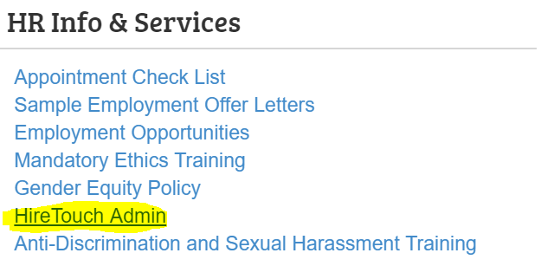
HIRE TOUCH ADMIN SITE

Slide 4
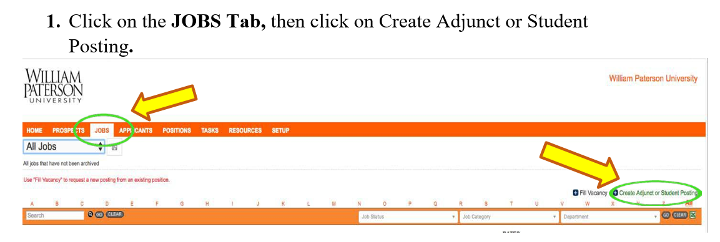
CREATING A JOB POSTING FOR NON-FEDERAL WORK STUDY POSITIONS
Hiring Manager to complete:

Slide 5
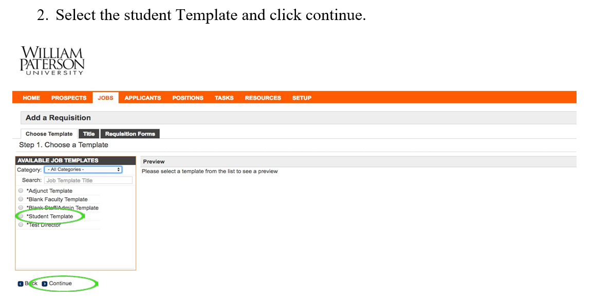
CREATING A JOB POSTING FOR NON-FEDERAL WORK STUDY POSITIONS

Slide 6
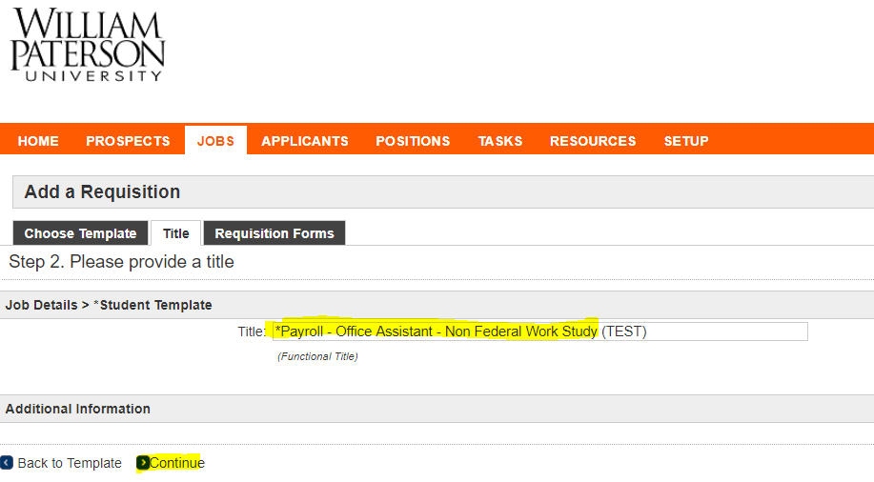
CREATING A JOB POSTING FOR NON-FEDERAL WORK STUDY POSITIONS
3. Type the Functional Job Title for the Posting and Click “Continue”

Slide 7
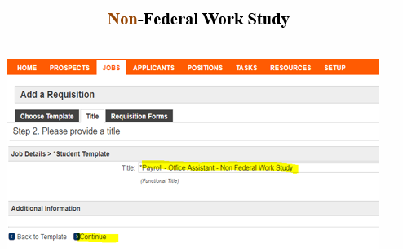
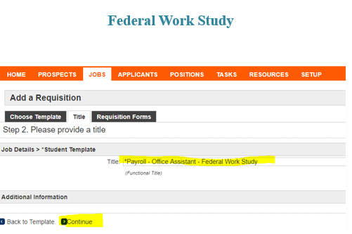
FUNCTIONAL TITLE FOR JOB POSTING
Please follow the below structure for creating the Functional Title for Job Postings:
Department / Position Duties / Funding Source

Slide 8
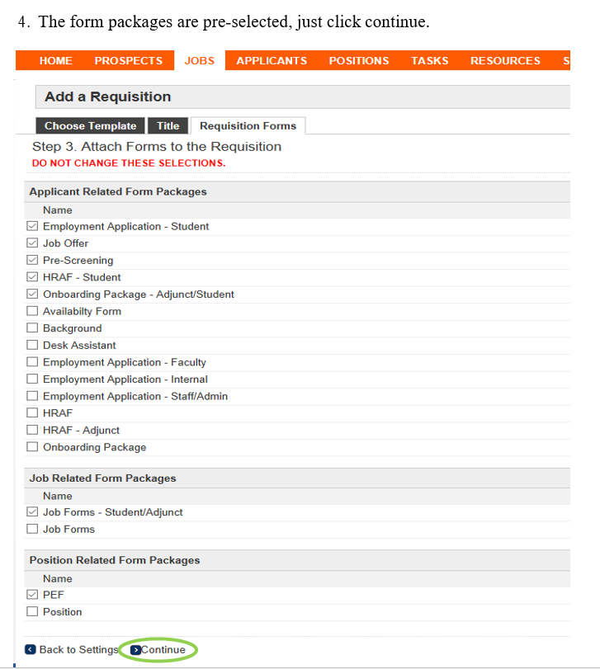
CREATING A JOB POSTING FOR NON-FEDERAL WORK STUDY POSITIONS

Slide 9
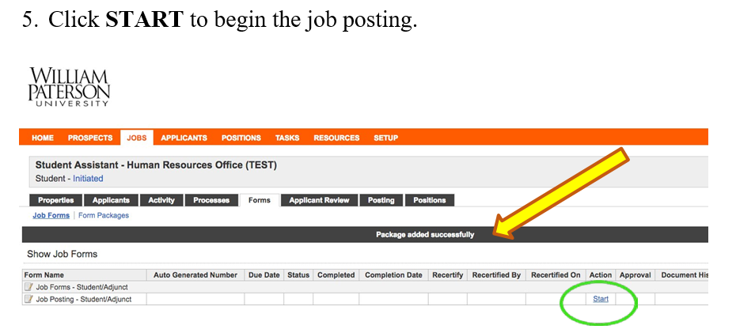
CREATING A JOB POSTING FOR NON-FEDERAL WORK STUDY POSITIONS

Slide 10
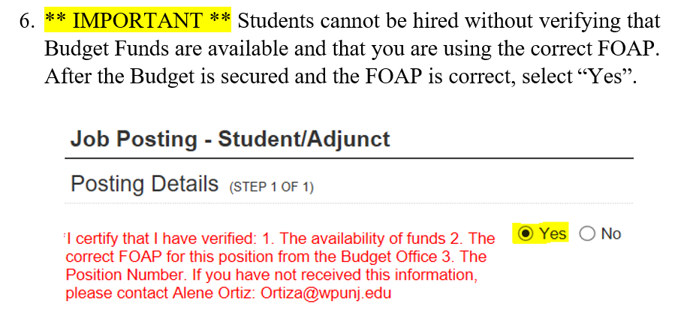
CREATING A JOB POSTING FOR NON-FEDERAL WORK STUDY POSITIONS

Slide 11
CREATING A JOB POSTING FOR NON-FEDERAL WORK STUDY POSITIONS

Slide 12
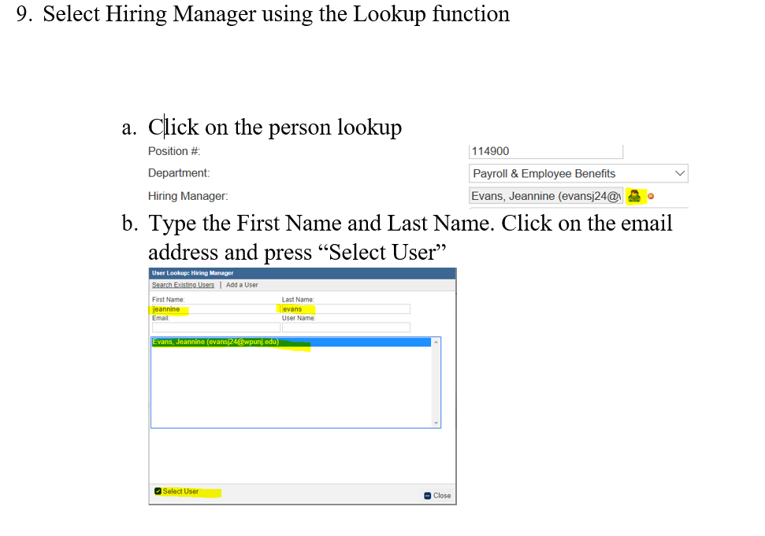
CREATING A JOB POSTING FOR NON-FEDERAL WORK STUDY POSITIONS

Slide 13
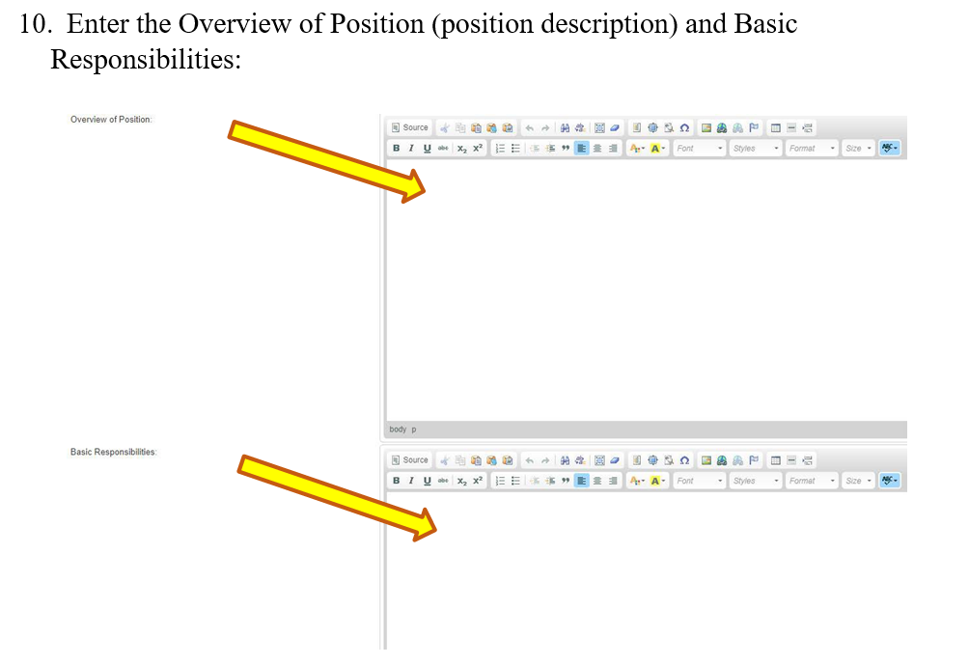
CREATING A JOB POSTING FOR NON-FEDERAL WORK STUDY POSITIONS

Slide 14
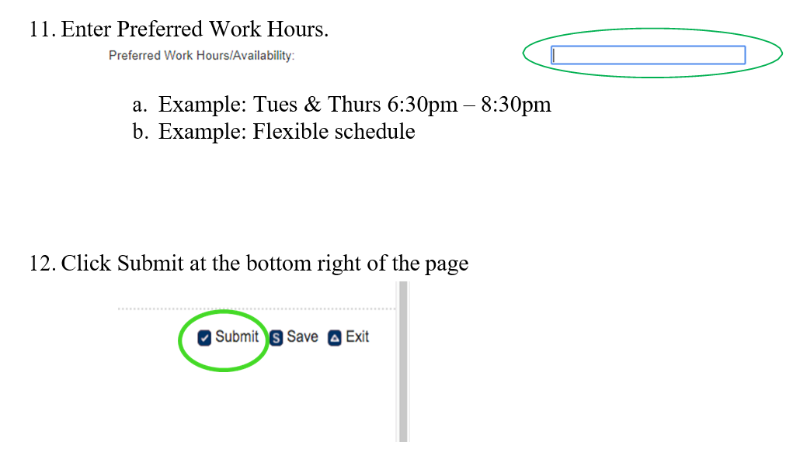
CREATING A JOB POSTING FOR NON-FEDERAL WORK STUDY POSITIONS

Slide 15
CREATING A JOB POSTING FOR NON-FEDERAL WORK STUDY POSITIONS

Slide 16
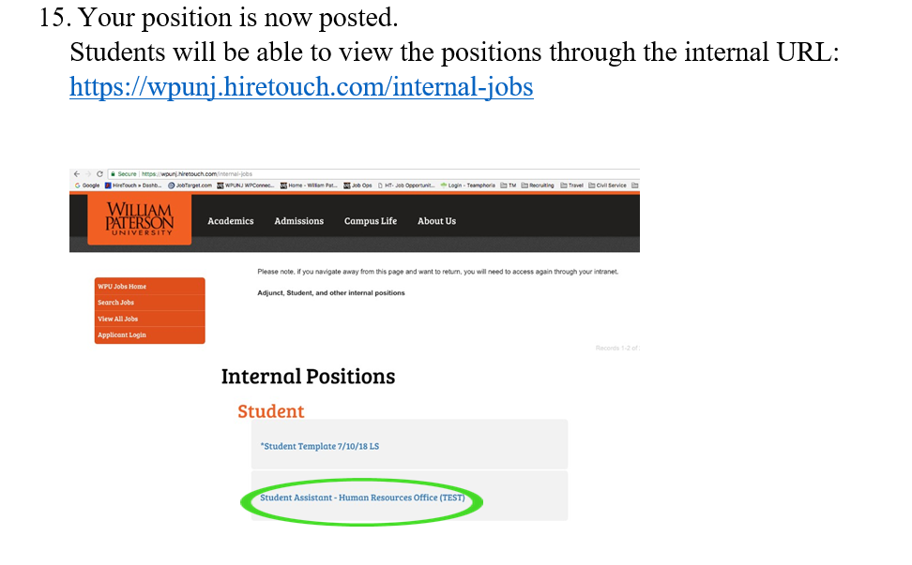
CREATING A JOB POSTING FOR NON-FEDERAL WORK STUDY POSITIONS

Slide 17
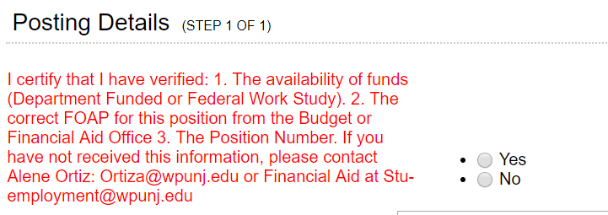
CREATING A JOB POSTING FOR
FEDERAL WORK STUDY POSITIONS
Complete previous steps, except please also follow the below:
1. ** IMPORTANT ** Verify this is an approved FWS position. After confirming with the Financial Aid Office, select “Yes”.
2. Federal Work Study Position Number is 11290N

Slide 18
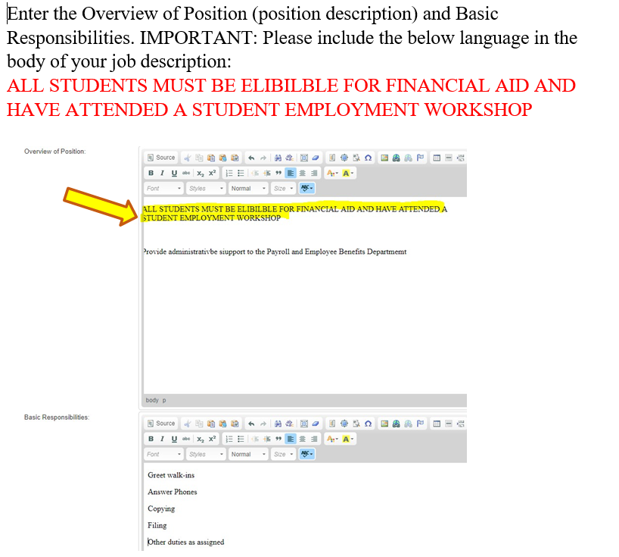
CREATING A JOB POSTING FOR
FEDERAL WORK STUDY POSITIONS
3.
Job Related skills i.e. if you are looking for accounting help, etc.

Slide 19
Questions?

Slide 20
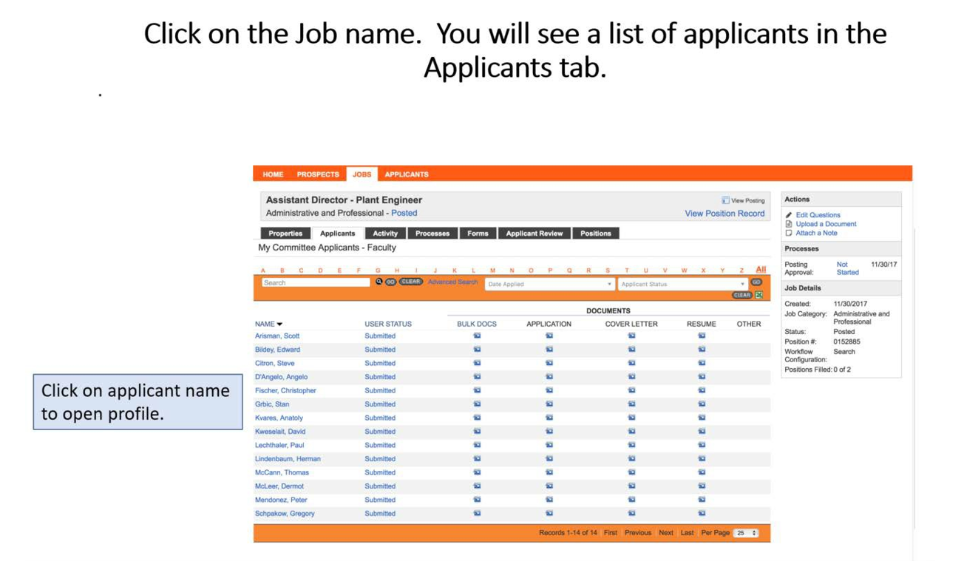
REVIEWING APPLICANTS

Slide 21
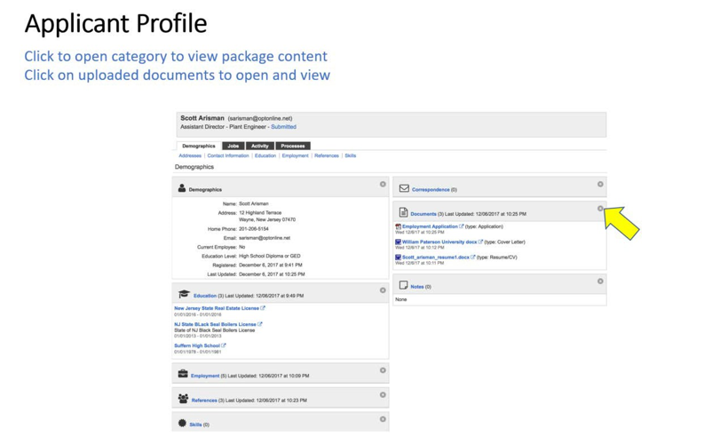
REVIEWING APPLICANTS Cont.

Slide 22
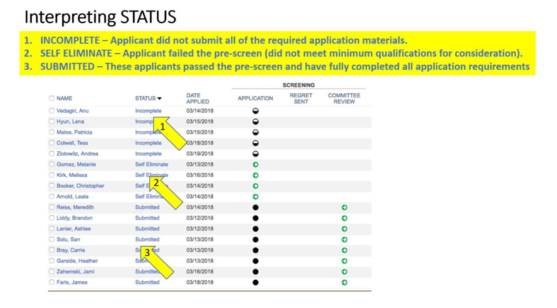
REVIEWING APPLICANTS Cont.

Slide 23
REVIEWING APPLICANTS Cont.
The Interviewing Process
At the interview, supervisors will present the students with the complete job description and discuss:
The function of the department
Specific responsibilities and tasks that involve a student employee
Needed or desired schedule (weekend hours, specific hours during the day, etc.)
Type of supervision and training available
General expectations of employees
Skills students would bring to the job
Student’s experience with positions of this type

Slide 24
REVIEWING APPLICANTS Cont.
The Interviewing Process
Example Interview Questions
Tell me about yourself
Why are you interested in this work study position?
Why did you choose WPUNJ? Major?
What is your Greatest Strength
What is your Greatest Weakness?
What qualifications do you possess that will make you successful in this position?
Tell me about a time you were part of a team?
Tell me about a time you had to make a quick decision. What did you do?
Tell me about a recent problem you encountered and how you solved it?
What courses have you liked the best?

Slide 25
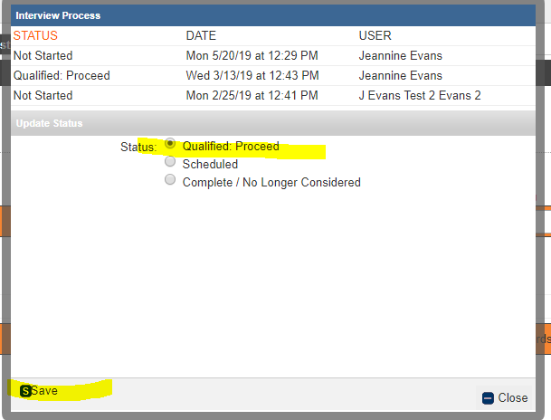
HIRING
To hire an applicant that has fully submitted the application, select the Green Arrow under the Interview Column to begin the hiring process. Please note you can also use the Bulk Actions to select several applicants at once.
In the pop up dialog box, select Qualified Proceed and Save

Slide 26
HIRING Cont.
Click on the Green Arrow under the STUDENT HRAF Column
Click “START” under the Action Column:

Slide 27
HIRING Cont.
The first step is to verify with the Budget Office or the Financial Aid Office that your department has the funds to hire a student(s). Complete required fields.

Slide 28
HIRING Cont.
The “Supervisor Name” should be the person responsible for completing the Time Sheets:

Slide 29
HIRING Cont.
The below will be automatically populated by the Position Posting:

Slide 30
HIRING Cont.
Please be sure when entering the Start and End Date for the HRAF it must fall within the current Fiscal Year
Please refer to the payroll schedule published on our website
Hourly Rate of Pay:
FWS: Determined by Financial Aid
Non-FWS: Coordinate with the Budget Office
*** Please note that the State Minimum Wage will be increasing twice in this Fiscal Year:
1. July 1, 2019
2. January, 2020
The minimum wage will continue to increase each January until the minimum wage hits $15.00 per hour

Slide 31
HIRING Cont.
ENSURE FOAP IS ACCURATE:
Federal Work Study: Financial Aid will enter the FOAP
Non-Federal Work Study: Use the Lookup (in Blue) to locate your FOAP
To be completed by Financial Aid Office

Slide 32
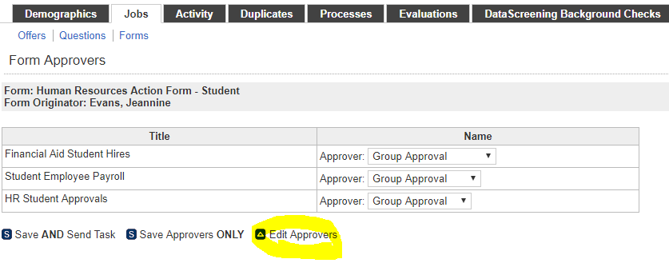
HIRING Cont.
When finished, click Submit and Continue to Approvals:
*** IMPORTANT ***
If this is a NON Federal Work Study Position, be sure to remove Financial Aid from the list of approvers:
Step 1:

Slide 33
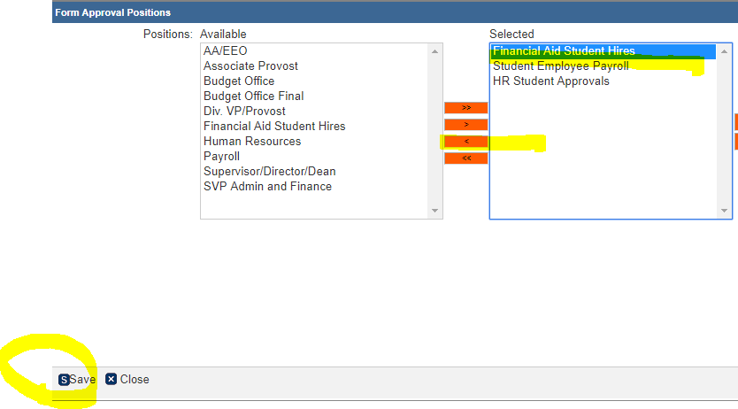
HIRING Cont.
Step 2: Click on Financial Aid, Click the Orange Left Arrow and Save:
Step 3: Select Save and Send Task

Slide 34
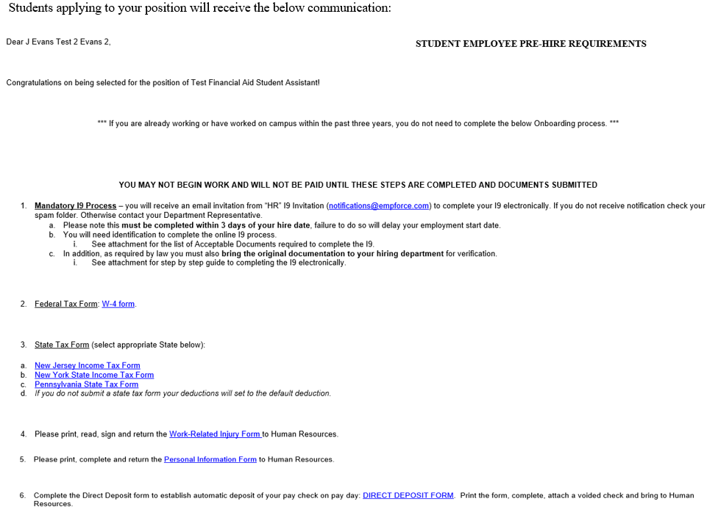
CORRESPONDENCE TO STUDENTS

Slide 35
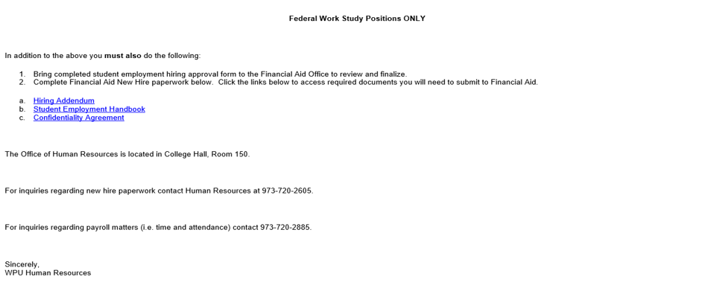
CORRESPONDENCE TO STUDENTS Cont.

Slide 36
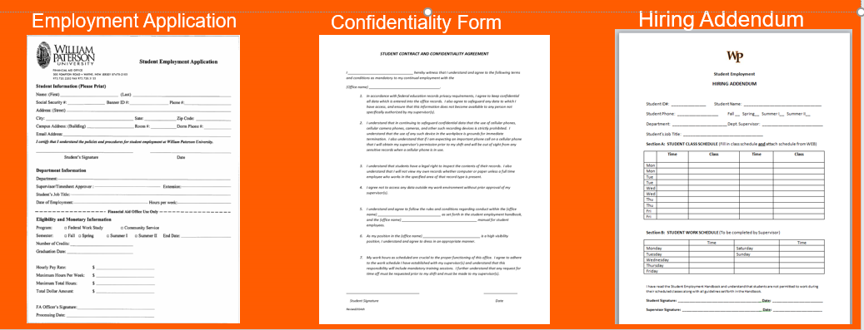
Required Financial Aid Forms
To be completed after the student attends the Mandatory Workshop, and offered employment by the Department.
New Hires complete the employment application within HireTouch.
Rehires will complete the paper copy provided by the Financial Aid Department.

Slide 37
Questions?

Slide 38
Rehiring student employees
Rehires: Students that worked for you in the prior year and are coming back in the same position for the following Fall semester:
Non-Federal Work Study: Send email to the Budget Office and include: Name, Start / End Date, Rate of Pay, Supervisor, Time Location and FOAP
Federal Work Study: verify eligibility with Financial Aid Office before emailing Budget Office.

Slide 39
Completing PT Time Sheets
1. Access the PT Time Sheet System in WP Connect
2. Make sure you review the timesheet!
a. Verify Hours worked
b. View hours by day, week and pay period
c. Comments made by the Employee can be reviewed
d. Timesheets can be printed by selecting Print Timesheet on the top left
3. Verify Time Location
4. Approve timesheets on time!

Slide 40
NJ Paid Sick Leave Act (NJPSLA)
Employee Entitlements:
Part time employees begin to accrue paid time off beginning October 29, 2018 or upon hire, whichever is later, under the following terms and conditions:
Employees accrue one hour of paid time off for every thirty (30) hours actually worked.
Employees can earn a maximum of 40 hours of paid time off over a 12 month “benefit year”. William Paterson University’s benefit year commences on July 1 and ends June 30.
Employees may carry over any earned but unused paid sick leave balance into the next year but are limited to 40 hours per benefit year.
Employees are not entitled to any payout for accumulated but unused paid time off upon separation voluntarily or involuntarily. If the employee is reinstated by the University within 6 months of the separation date, then all of the employee’s unused sick time will be reinstated.

Slide 41
NJ Paid Sick Leave Act (NJPSLA)
Employees can use earned sick leave:
For diagnosis, care, treatment of, recovery from their own or their family member’s mental or physical illness, injury, or other adverse health condition or for preventative medical care;
For treatment/counseling/services for domestic or sexual violence in connection with themselves or family member;
For closure of employee’s workplace or child’s school/care by order of public officials, or presence of them/family member in community would jeopardize health of others; and
To attend a school-related conference, meeting, function or other event requested or required by child’s school or regarding care of child’s health condition.

Slide 42
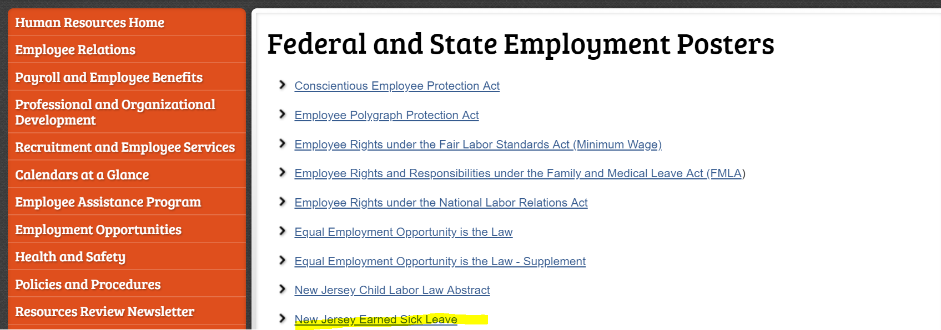
NJ Paid Sick Leave Act (NJPSLA)
More Information:
https://www.nj.gov/labor/earnedsick/

Slide 43
NJ Paid Sick Leave Act (NJPSLA)
Federal Work Study and Student Employees:
Student employees will accrue sick time using the rate of one hour for every 30 hours worked.
Student Employees: Payment of sick leave for Non-Federal Work Study students will be charged to the Department’s budget.
Federal Work Study Student Employees: Payment of sick leave cannot be charged to work-study budgeted funds. For student workers employed under the Federal Work Study Program, the cost of the sick leave will automatically be charged to a designated University funding source.

Slide 44
NJ Paid Sick Leave Act (NJPSLA)
The Payroll and Employee Benefits Office has been working with IT to configure the relevant systems to accommodate the new regulations. Once complete, our office will send communication on how to code sick leave in the Timesheet system. In the interim, please follow the below:
To use earned sick leave, student employees must first notify their Department Supervisor of the intended absence. Subsequently, the department should immediately inform the Payroll Department via email at payroll@wpunj.edu to process the request for paid sick leave usage.

Slide 45
Questions?

