Slide 1


Financial Literacy:
Skills for Taking Charge of Your Financial Success
Review of the Economic Consequences of Delaying Graduation

Slide 2
Decisions Now…
If you were to decide right now that…
You wanted or even needed to be a college student for five to six years you might:
    Enjoy the college life longer (i.e., Party Time!)
    Spread out the academic stress and maybe enhance your GPA (concerns about performance)
    Delay the enviable: Becoming a real life working adult (yikes!)

Slide 3
…Later Effects
But you would have added another
$24,000
of higher education debt then if your plan was to complete your studies in just four years

Slide 4
National Perspective
Student loan debt now exceeds consumer credit card debt (over $1.2 trillion)
      Consumer Financial Protection Bureau
“Three-fourths of the fall in household formation can be directly correlated to student debt,”
      Rohit Chopra, student loan ombudsman at the Consumer Financial Protection Bureau

Slide 5
National Perspective
    Survey conducted by American Student Assistance highlighted that impact of student loan debt:
    Hinders the Purchasing Power of individuals (delays the purchase of homes, cars, etc.)
    Delays in personal choices (marriage and starting a family)
  Percentage of respondents that indicated impact of debt:
    63% delayed car purchase
    75% delayed home purchase
    73% delayed retirement savings
    29% delayed marriage plans
    43% delayed starting a family

Slide 6
WP Student Perspective
According to the Newly Admitted Student Questionnaire (Fall 2013)…
93% of students said the Price of Tuition was a “very” or “moderately” important factor in deciding to attend WP and
84% of students said Financing My College Education was “very” or “moderately” concerning to them
  WP Institutional Research and Assessment

Slide 7
Illustration Scenario
Billy Bear*
Tom Turkey*
*profiles are similar except for selection of major

Slide 8

Billy Bear’s Bio
Career Oriented
Was a Student Leader in HS and now at WP
Achieve Success through Education
Declared Major at Time of Admission

Slide 9

Tom Turkey’s Bio
Career Oriented
Was a Student Leader in HS and now at WP
Achieve Success through Education
Undeclared Major at Time of Admission to Explore Career Options
Making the Right Career Decision Was a Driving Force in Not Selecting a Major

Slide 10
Will That Be Four Years or Six?
Since Billy was certain of his career path he incurred tuition and fees charges of $45,500* in four years:
$11.0k
$11.3k
$11.5k
$11.7k
*assumes a tuition increase of 2% per year and figures are rounded
*only direct billable costs are factored; incidental educational expenses not included

Slide 11
Will That Be Four Years or Six?
Tom’s pursuit of “career nirvana” surpassed the $45,500 total due to the two additional years of schooling
Tom’s total is $69,500* in six years
$11.0k
$11.3k
$11.5k
$11.7k
$11.9k
$12.1k
*assumes a tuition increase of 2% per year and figures are rounded
*only direct billable costs are factored; incidental educational expenses not included

Slide 12
…Basic Math
Tom Turkey added another
$24,000
of higher education debt even though his rationale was sound!

Slide 13
Academic and Financial Planning Are Not Separate Issues
Academic Planning will directly influence your Financial Planning and Vice Versa
Seek advice: Often and Early
Great resource in the Academic Advisor

Slide 14
Resources Abound
Institutional:
    Office of Student Enrollment Services
    Office of Financial Aid
    Faculty/Academic Advisor
Governmental/Vendor:
    Federal: Studentloans.gov
    State: Hesaa.org
    Non profit and propriety vendors:
        Nelnet
        American Student Assistance
        Inceptia (National Student Loan Program NSLP)
        Wells Fargo
Although useful this approach is not a concerted/cohesive one that leverages all the university has to offer

Slide 15
WP Plan for Financial Literacy
University has contracted with National Endowment for Financial Education (NEFE)
CashCourse is an online tool the provides literacy content in addition to self testing for students.
Locally, the overall design, implementation and future of Financial Literacy will be directed by the Committee of Financial Literacy that represents areas in:
Academic Affairs
Student Development
Administration and Finance
Enrollment Management
The focus will be on collaborative cross functional partnerships to assist in elevating student Financial Literacy.

Slide 16
WP Plan for Financial Literacy
CashCourse is an online tool the provides literacy content in addition to self testing for students.
Content offered through:
Coursework and Quizzes
Articles
Videos
Calculators
Ask a Financial Expert

Slide 17
WP Plan for Financial Literacy
Areas covered are:
Budgeting
Student Loan Repayment
Credit Cards
Resources for the Paying for Schooling
Debt
Identity Protection
Consumer Loans
Banking Basics
Investing
Taxes
Insurance

Slide 18
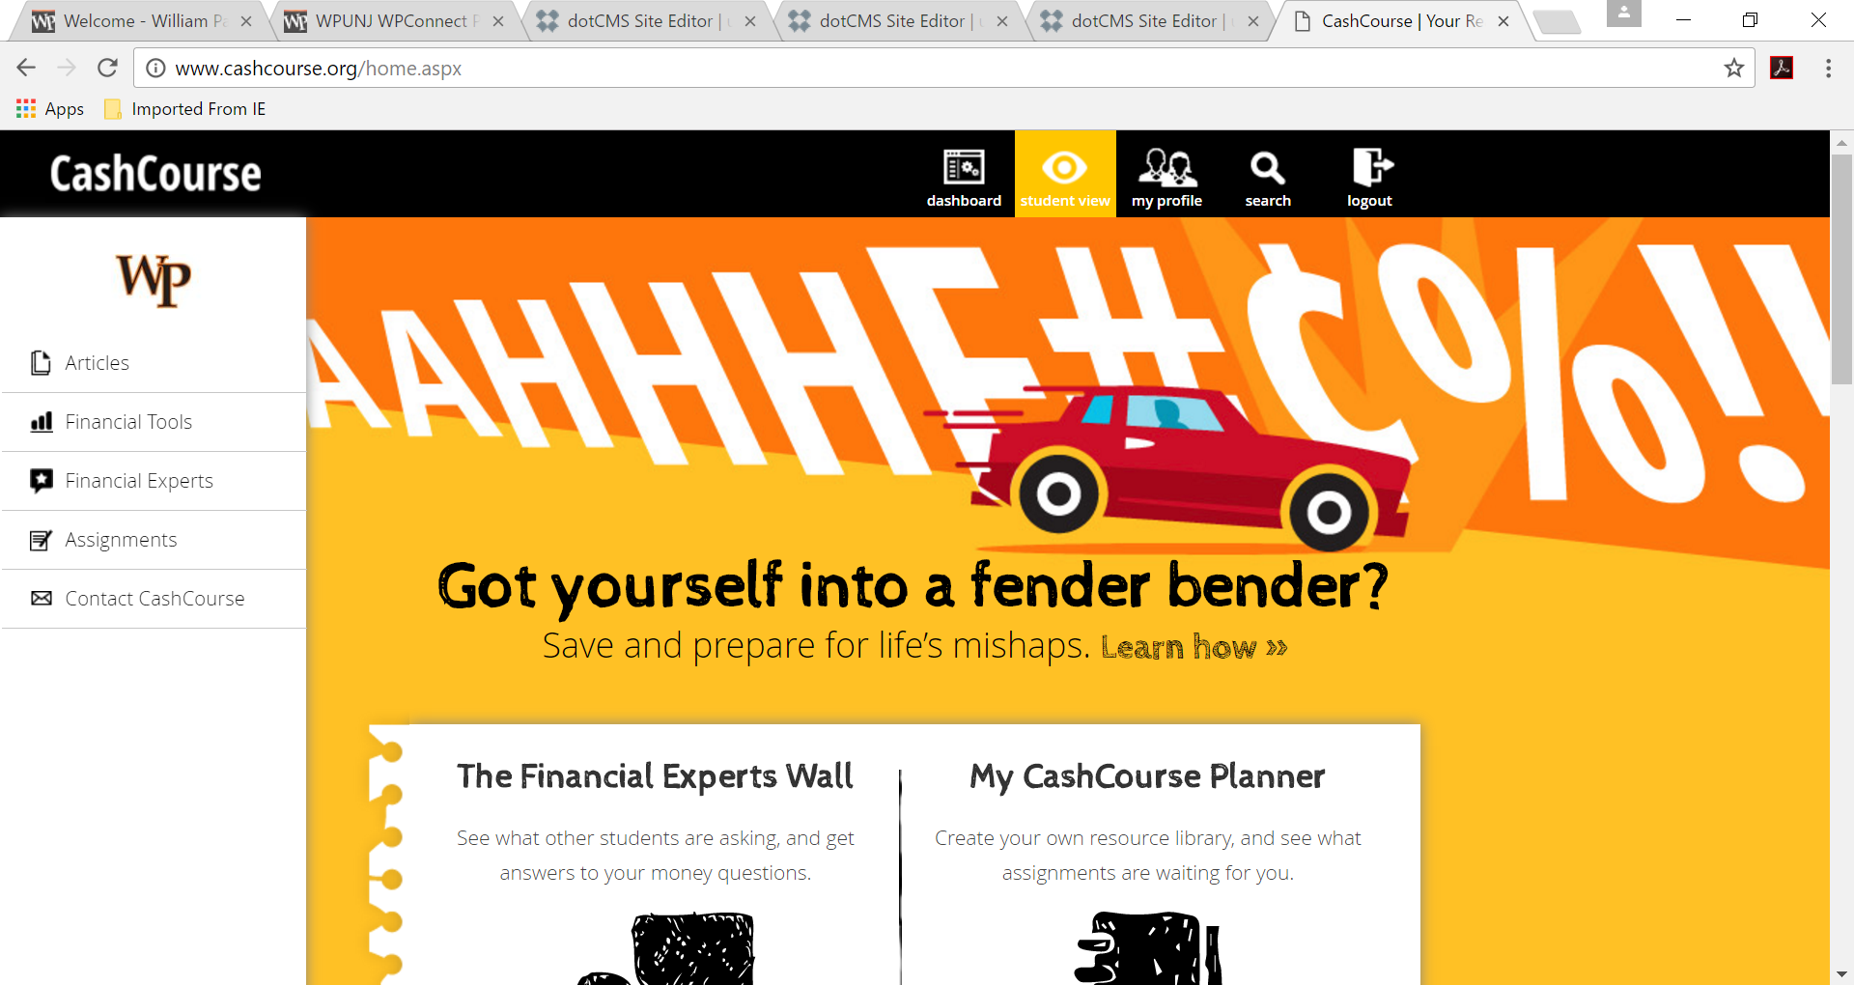
WP Financial Literacy Website
http://www.wpunj.edu/financial-literacy/index.dot

Slide 19
Questions? Contact the Office of Student Enrollment Services at www.wpunj.edu/centerss or studentservices@wpunj.edu or 973.720.3945

