Slide 1
Welcome to 2023 RBI Sales Triathlon
Russ Berrie Institute for Professional Sales
Cotsakos College Of Business
William Paterson University
Notes:
Thank you, Mike. Welcome students and faculty. We are very proud to be a sponsor and appreciate the opportunity to work with the faculty and students. This experience has been very collaborative with the very impressive team of professors. It has helped us to sharpen our message about Digital Transformation. Combining Business consulting with Technology consulting to help our business customers not just add more technology, but to transform how they do business.

Slide 2
Agenda
Baroan Technologies History
Business and IT - no longer separate
The Business / Technology Gap
Baroan Technologies Pyramid as the solution for SMBs
Examples
Q&A
Notes:
Baroan Technologies History
Business and IT - no longer separate convergence with automation and analytics
The Business / Technology Gap
Baroan Technologies Pyramid
Baroan Pyramid as the solution for SMBs
Q&A

Slide 3
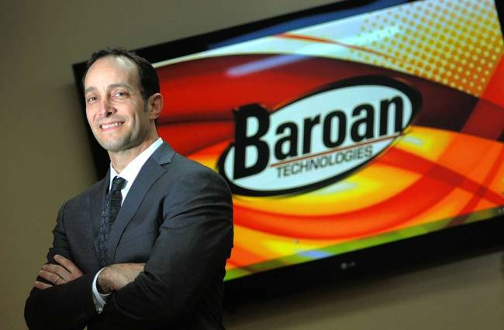
Guy Baroan, President – WPU Graduate
Notes:
Baroan Technologies (BTI) was founded in 1997 by a WPU Graduate Guy Baroan, President of BTI.
Dimitris Miaoulis – VP & Partner at Baroan Technologies for the past twenty-four years.

Slide 4
Baroan Technologies Evolution
BTI started in 1997
Value-Added Reseller (VAR)
Managed Services Provider (MSP) – RMM & Automation
Virtual Chief Information Officer services (VCIO)
Digital Transformation Advisors (Dx)
Baroan Technologies Pyramid – Culmination of 25 years
Notes:
Baroan Technologies Transition to Dx Consulting
BTI started as Value-Added Reseller – in this business model we added value by installing and troubleshooting technology. It was a simple reactive break/fix model. If you needed help you called us.
Within a year of starting the company we joined the E-Myth Mastery Program – it was business improvement program that helps a company – strategically systemize and document the business. We worked closely with a consultant for three-years to complete the program.
That program helped us evolve into a proactive Managed Services Provider model – Remote Monitoring and Management (RMM) of the network. We focused on Automation and eventually created a software company that has other MSPs leverage what we created with our automation platform.
As we continued to evolve, we began to help our clients with their businesses by leveraging our experience from what we learned from the E-Myth. We enhanced the Virtual Chief Information Officer VCIO services to the next level. VCIOs primarily manage the life cycle of the technology.
The next step to improve our services for our clients was to become Certified Advisors for Digital Transformation (Dx). We joined the Digital Maturity Group to help us deliver the Dx services and collaborate with like-minded Advisors.
We now formally combined Business best practices with Technology best practices.
We adopted a web-based platform to help organize and deliver these consulting services.
The Dx platform and methodology provide our clients with a cost effective and consistent methodology with set fees, processes, and deliverables. Changing the consulting game away from an unknown “money pit” to a predictable cost with predictable results.

Slide 5
25 Years in the Making
Notes:
Visit www.baroan.com and click on Learn More link at the base of the pyramid.

Slide 6
Notes:
And we are very proud that we built our pyramid faster than these guys did.

Slide 7
Notes:
The GAP – Businesspeople are not IT people and IT people are not businesspeople.
Some background information about the difference between CIO and Digital Transformation Advisor because this question usually pops up. “Doesn’t a CIO do this?” Basically, a CIO is IT focused.
A Digital Advisor focuses on people by team collaboration - Assess and plan communication and collaboration among teams to not just select proper applications but plan the adoption and training. In contrast the CIO / IT Manager focuses on making sure that team collaboration applications are budgeted and giving users access to the tools, assuming that they know how to collaborate effectively with those tools.
A Digital Advisor focuses on processes by enhancing operation efficiency - Identify needed processes (confusion) or lack of process automation (manual work) and plan standard operating procedures and applications to support those processes. In contrast a CIO / IT Manager will connect or integrate various systems together based on specific user requirements assuming the users planned the processes.
A Digital Advisor focuses on digital platforms by seizing emerging business opportunities - Identify organizational bottlenecks and select either e-commerce, social media or service platforms to increase marketing, sales or operational results. In contrast CIO / IT Managers focus on ensuring all users have access to these platforms assuming that the users know why and how to operate those platforms.
A Digital Advisor focuses on information by enabling quick, more informed decisions - Assess the information needs of executives and managers then identify the current silos of information and plan an analytical and reporting structure that can engender more informed decision making. In contrast CIO / IT Managers focus on finding and installing BI, Reporting or Analytics applications assuming that the users will use it effectively.
A Digital Advisor focuses on applications through effective utilization of software solutions - Assess current application portfolios, business capabilities and help the organization to articulate requirements and generate an application modernization plan. In contrast CIO / IT Managers focus on finding and recommending applications assuming users know how to define requirements and how to train and adopt the tools successfully.
A Digital Advisor focuses on risk by managing the security of digital transformation - Identify the business, infrastructure, executive, user and client risks of the current digital situation and address the hotspots. In contrast CIO / IT Managers focus on cybersecurity back-end technology security components assuming that the users have all the knowledge, processes and policies in place.
A Digital Advisor focuses on Digital Transformation Strategy with Digital Vision, Roadmap and Execution - Use a straightforward process to generate the Digital Vision, a Digital Strategy, an Implementation Roadmap and Execution Plan in order to enable tech people to help the organization to thrive. In contrast CIO / IT Managers focus on an IT Infrastructure Strategy and budget assuming each organization needs standard solutions to adopt various technology trends.
Role Play One you’re going to convince Jordan to meet for a Business Improvement Review (B.I.R) By describing the benefits of the Pyramid. (Baroan’s Business Model and solution stack)
Discovering The Gap – Opportunities for improvement.
How does the GAP apply to your role play?
On the left you have the typical flow of events. The owners set goals for sales, profitability and all the metrics associated with those goals.
The owners task the executives and management to find a way to achieve those goals. They do research and inevitably it involves a technology solution. Everything in a business touches technology. Hence the term Digital Transformation being used so much. If you want to transform your business, it will involve technology.
Now the Gap happens – No Discovery Workshop to involve the stakeholder’s and how they do their work.
The selected solution gets delegated to the internal IT department, or the outsourced Managed Service Provider (MSP) to be installed, backed up, provide access to employees and ensure the solution is secure. The project is not successful Little or no ROI and no one is happy about the lack of results.

Slide 8
Summary
Baroan Technologies History
Business and IT - no longer separate
The Business / Technology Gap
Baroan Technologies Pyramid
Baroan Pyramid tied back to Krypton Metals
Examples
Q&A
Notes:
Summary
Baroan Technologies History of evolution towards the holistic solution of the Baroan Pyramid.
Business and IT - no longer separate – when they are separate, it creates a Gap.
The Business / Technology Gap – the people using the solution are rarely part of the selection and customization process. This is where the projects fail, this is the Gap. The Discovery Workshop. In the fourth level of the pyramid employees are engaged to participate which creates buy-in for the new solution. As opposed to, “here is the new solution, use it.”
Baroan Technologies Pyramid – is our business model that creates success in transformative IT projects and helping businesses self-actualize by becoming the best version of themselves. You need best practices in the network, to apply security, you need to manage the alignment to best practices which mitigates risk. These first three levels provide efficiencies, increasing employee satisfaction by reducing frustration and increasing productivity. Working with the end users of solutions by understanding their workflows will ensure you select the solution capable of filling their needs and finally you need to plan strategically for the future to be competitive and survive.
Read the role plays in the context of the Baroan Pyramid and connect the pyramid and process to Krypton Metals
Q&A

