Slide 1
Grant Search Tools:
How To Envision your Project and Find Funding Opportunities
Office of Sponsored Programs
Raubinger Hall, Room 309
William Paterson University
973-720-2852 May 21, 2013

Slide 2
Agenda
Introduction to the Office of Sponsored Programs: Who we are
Three major areas of activity: What we do
What about foundations? Institutional Advancement, why two funding areas
Resources available to search for grants at WPUNJ
How to get started: What do you really want to do?

Slide 3
Resource #1
The Office of Sponsored Programs
Primary Focus:
  Proposals to government agencies, public charities and large foundations
  Support for research, teaching, community service, public programs, creative endeavors, conferences, other
Three Major Areas of Activity:
  Pre-Award Services & Resources
  Post-Award Services & Support
  Compliance

Slide 4
Pre-award Services & Resources
Funder identification, reference center
Publications:
  Dates, Updates & Insights (DUI) email announcements
  STAR Report
  Web site
Training: at WPU and conferences; funder visits
Idea and project development, proposal preparation guidance/assistance, institutional review, submission
Support and encouragement:
  Senate Research Council, University Research & Scholarship Day
  Conferences, meetings with funding agencies

Slide 5
Contact Information
Staff:
    Martin Williams, Director EXT 3263
    Lourdes Bastas, Assistant Director, Pre-Award Services EXT 3794
    Maureen Peters, Program Assistant EXT 2852
    Stephen Hahn, Associate Provost EXT 2565
Office:
    Raubinger Hall 309
    Fax: 973-720-3573
    Webpage:
    www.wpunj.edu/osp

Slide 6
Resource #2
Search Tools: Print Format
Directories and Newsletters
    Comprehensive or General Interest
    Special Interest: Agency, association and third-party
      Multiple indexes: subject, type, location
    Featured Element in a general interest publication
Other publications
    Professional journals
    Newspapers

Slide 7
Resource #3
Search Tools: People
Office of Sponsored Programs Staff
Colleagues
    In department, professional associations, peers
Conferences
    Grants Major Element:
      Grant Resource Center, Training Workshops
      National Council of University Research
    Grants Minor Element: Session or exhibitor
Office of Sponsored Programs Staff
Colleagues
    In department, professional associations, peers
Conferences
    Grants Major Element:
      Grant Resource Center, Training Workshops
      National Council of University Research
    Grants Minor Element: Session or exhibitor

Slide 8
Resource #4
Search Tools: The Internet
Internet-based Databases Subscriptions
    Grant Search
    Pivot
    Grants.Gov
Free Internet Search Tools
    What’s your favorite search engine?
    Organizations: e.g. Foundation Center
Helpful Hints: Use “Keywords” or funder’s terms
Start narrow then broaden

Slide 9
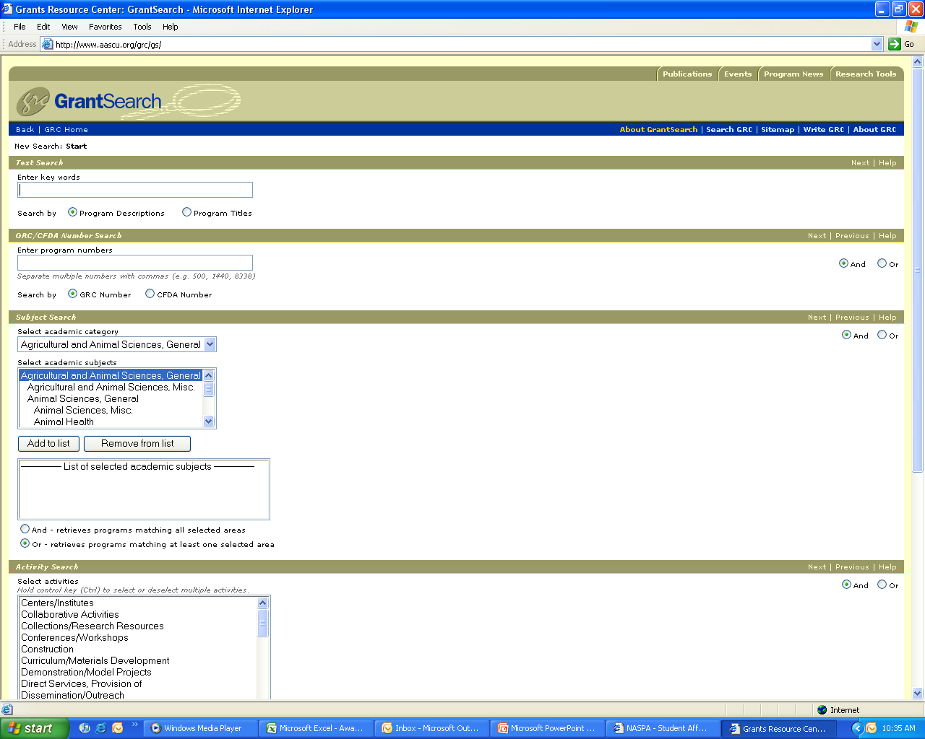

Slide 10
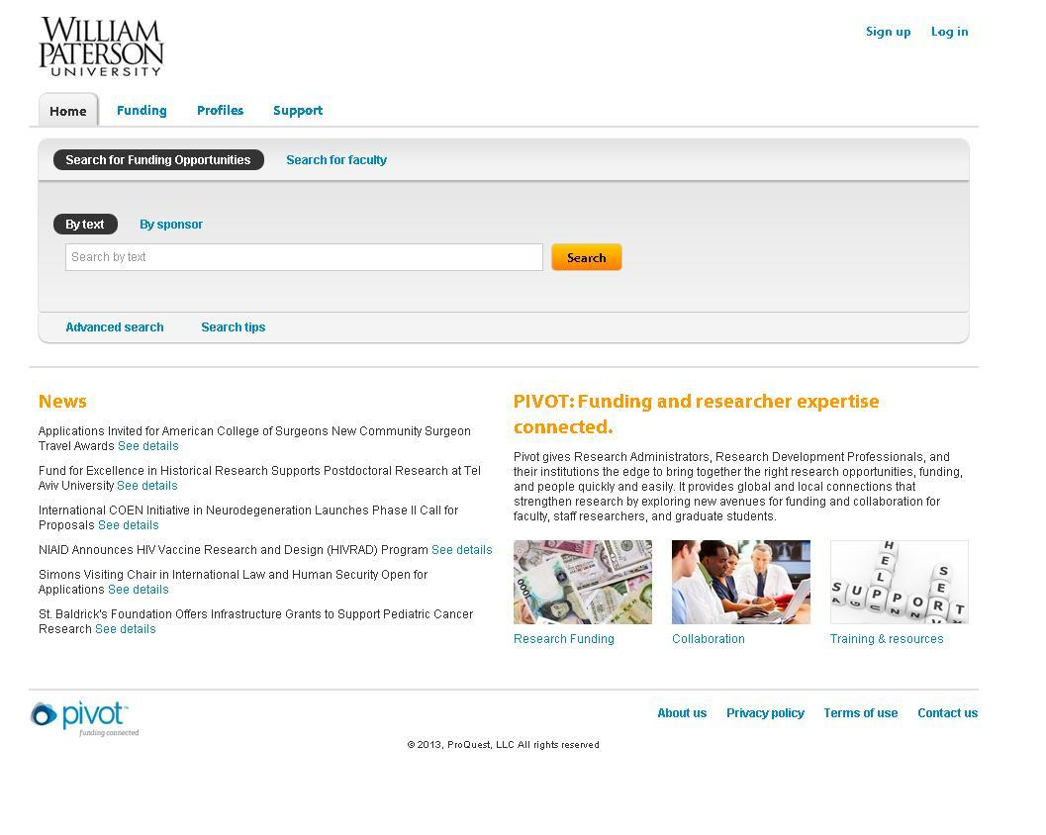

Slide 11
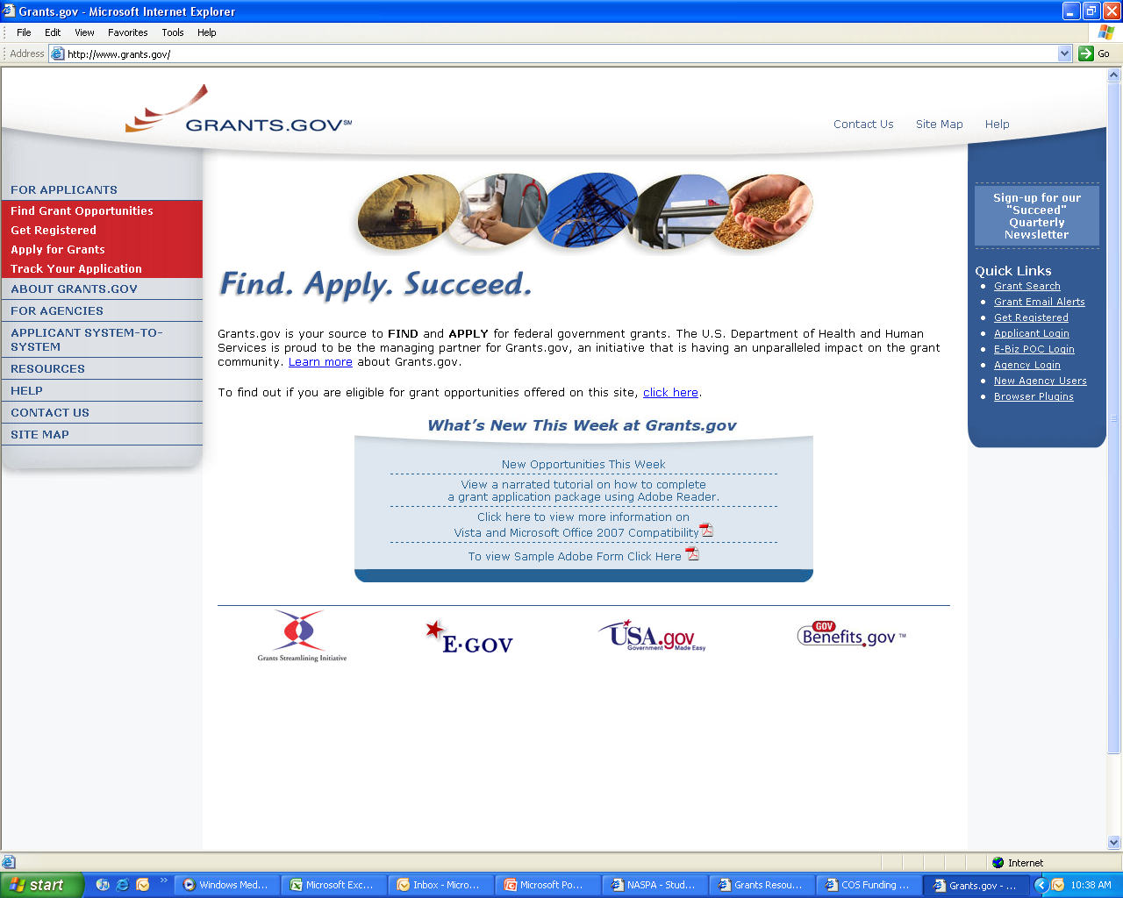

Slide 12
Proposal Development Process
Initiate Ideas: Things to Think About
Would doing this project truly further your research and career? If not, why do it?
Who will be the Project Director? Should you have collaborators? Partners?
How big is the project? How broad a scope? How long will it take?
Will your idea be supported by your chair, dean, the provost? Does it fit into the University’s Strategic Plan?
How big of a budget will you need?
What other resources will you need? Release time? Lab space? Paid personnel?
Will you need approval for human or animal subjects?

Slide 13
Proposal Development Process
Find appropriate funders
Refine idea, develop project, outline proposal
Meet with OSP; contact funder
Draft proposal; contact consultants and partners, begin collecting support materials
Meet with OSP to review draft, develop budget, schedule submission
Submit nearly finished narrative and budget for review and signature, about 10 days to deadline
Finalize proposal package, submit early

Slide 14
How to Develop a Fundable Proposal
Overview of a Complete Proposal
Guidelines First!
Review Criteria & Processes
Developing Each Component
Some Helpful Hints

Slide 15
Overview of a Complete Proposal
Cover Page, forms, signatures
Budget, budget support, other forms
Abstract
Narrative
  Background and problem statement
  Goals and objectives
  Activity Plan
  Evaluation
Appendix and support material

Slide 16
Guidelines First!
Read the Guidelines Thoroughly to:
  Verify Eligibility for the grant program
  Establish Connection to the funder’s mission, goals and the grant program’s expected outcomes
  Learn the Details of the application process, format, including special information or review requirements
  Get Answers to Questions: Call the Program staff!
  Evaluate whether the program is right for you, your project and the University

Slide 17
Review Criteria: Content
The first & most important review issue is
  Intellectual Quality/Merit/Significance:
  How will the project advance “knowledge and understanding in its own field or across different fields?” (NSF)
  Does it “address an important problem?” & “How will
  scientific knowledge or practice be advanced?” (NIH)
  ”Is it “broadly conceived, based on sound scholarship, and appropriately analytical?” (NEH)
  ” The extent to which the design of the proposed project reflects up-to-date knowledge from research and effective practice.” (US Dept of Education)

Slide 18
Other Aspects of Intellectual Quality/Merit/Significance
  Other Intellectual Quality Issues:
    Originality/Innovation: Does it address an innovative hypothesis or employ novel concepts, approaches, methodologies, tools or techniques?
    Validity of the need, goals, objectives and supporting information as presented
    Quality of participants
    Realistic design and likelihood for success
    Conducive facilities and environment

Slide 19
Review Criteria: Content
The second most important review issue is
  Potential Broader Impact
  On project participants (you, others; direct, indirect)?
  On the service/support environment/infrastructure?
  Of the data or insights to be produced?
  Of how others will use the outcomes?
    A Key Aspect to address is dissemination:
    How will you share the outcomes with others?

Slide 20
Other Aspects of Potential Broader Impact
  Other Broader Impact Issues:
    How well will the project/activity:
      Promote integration of service, research and education?
      Broaden the participation of underrepresented groups (e.g. genders, racial/ethnic minorities, persons with disabilities)?
      Benefit your community and society in general?

Slide 21
Review Criteria: Technical
Was a Letter of Intent or Preliminary Proposal Required?
Forms: Cover sheet, summaries, assurances
Format: Length, margins, font size, attachments
Organization: Specific sections in specific order
Special Requirements: Human Subjects, ADA
Letters of Commitment: Partners, Evaluators
→ THESE ARE EASY EXCUSES TO REJECT PROPOSALS

Slide 22
Review Process
1. Self/Institutional review before submitting
2. Technical review when received
3. First program staff review
4. Peer/Committee review: selection and scoring
5. Second program staff review: ranking and selection
6. Program executive officer/board review: approval
7. Contract office review: negotiation and award

Slide 23
Before the Proposal
Research
  Similar programs, core issue, related issues
  Gather data supporting your idea and proposed of activities (census, research findings)
Undertake preliminary activity
  Test proposed activities and/or collect preliminary data
  Determine outcome estimates
DEVELOP THE PROJECT
  Don’t wait until you start writing
  Will identify issues that need resolution
  Provides time to think about what you are going to do

Slide 24
It’s All About the Program
How you probably feel right now !
Grant proposals
are hard – but very
“do-able.”

Slide 25
Helpful Hints: Content
Be innovative wherever possible
  Based on what others are doing
Focus on key questions
Be convincing and thorough
Demonstrate knowledge of subject
State the expected contributions (outcomes) to your field of work
Convey excitement and commitment
Clearly link to the funder’s priorities

Slide 26
Helpful Hints: General Tips for Success
Follow the directions/answer their questions
Talk to the Program Officer
Fulfill their review criteria
Ask for what you need
Be thorough in describing the project
Do not do the project or writing alone
Schedule time to write
Start early to insure there is enough time
Everything must “fit together”:

Slide 27
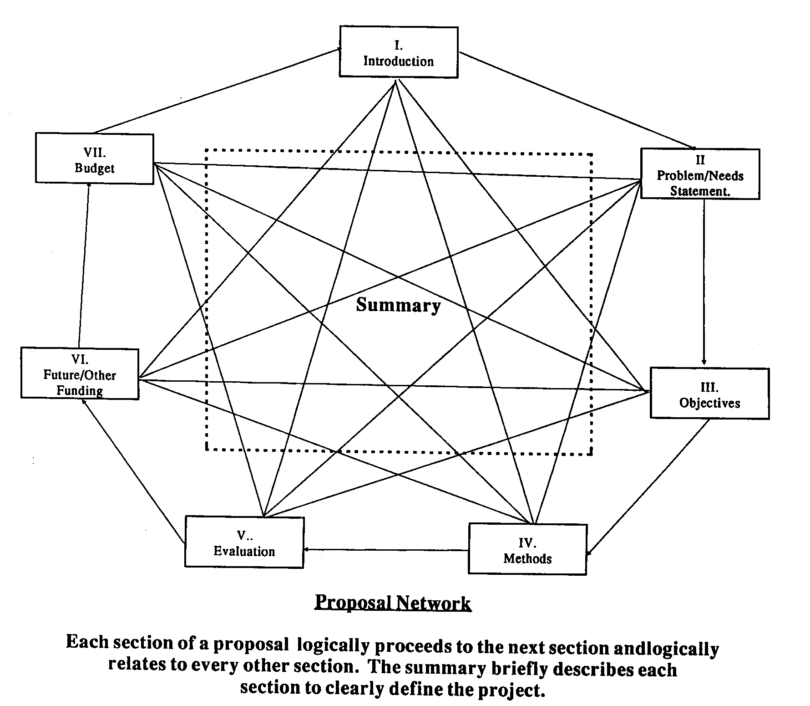
The Ultimate Goal of a Proposal
Abstract

Slide 28
Contact Information
Staff:
    Martin Williams, Director EXT 3263
    Lourdes Bastas, Assistant Director, Pre-Award Services EXT 3794
    Maureen Peters, Program Assistant EXT 2852
    Stephen Hahn, Associate Provost EXT 2565
Office:
    Raubinger Hall 309
    Fax: 973-720-3573
    Webpage:
    www.wpunj.edu/osp

