Slide 1
Applying for Grants:
It’s All About the Program
Office of Sponsored Programs
Raubinger Hall, Room 309
William Paterson University
973-720-2852 May 21, 2013

Slide 2
Agenda
WPUNJ Process, Policies and Procedures regarding grants
How to develop a fundable grant proposal, the nuts and bolts

Slide 3
Grant Development Process
Initiate Idea
Find appropriate funders
Refine idea, develop project, outline proposal
Meet with OSP; contact funder
Draft proposal; contact consultants and partners, begin collecting support materials
Meet with OSP to review draft, develop budget, schedule submission
Submit nearly finished narrative and budget for review and signature, about 10 days to deadline
Finalize proposal package, submit early

Slide 4
WPUNJ Policies & Procedures
Grant Approval Sheet:
Documents official support for project
Summarizes key elements, identifies special review needs
Assists in time management and in orchestrating the final review process to meet submission deadline
Project Director obtains Chair & Dean signatures
OSP obtains Administration & Finance signatures, Provost Office signatures, and signatures on proposal, support letters and other required documentation
Due in OSP 10 days before due date to:
  Obtain final signatures
  Assemble packet and prepare final documents and copies
  Submit

Slide 5
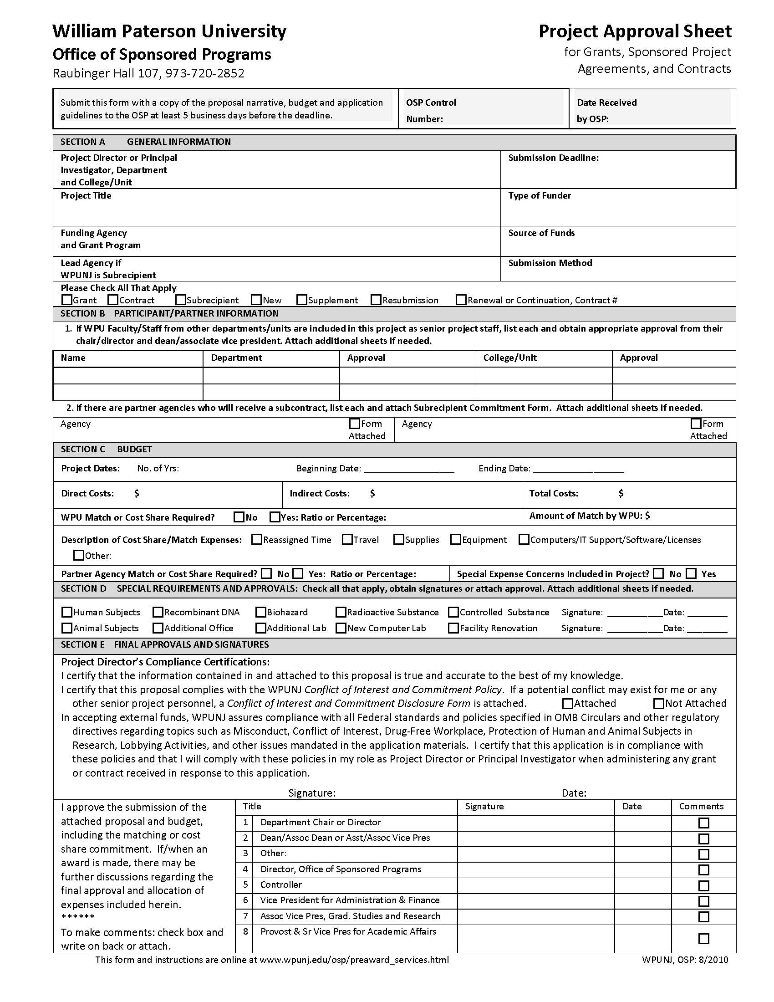
Project
Approval
Sheet

Slide 6
How to Develop a Fundable Proposal
Overview of a Complete Proposal
Guidelines First!
Review Criteria & Processes
Developing Each Component
Some Helpful Hints

Slide 7
Overview of a Complete Proposal
Cover Page, forms, signatures
Budget, budget support, other forms
Abstract
Narrative
  Background and problem statement
  Goals and objectives
  Activity Plan
  Evaluation
Appendix and support material

Slide 8
Developing Each Component
1. Activity Plan
2. Budget
3. Goals & Objectives
4. Background, Need(s), Problem(s), Benefits
5. Introduction: Credibility of PI/PD, WPU, etc.
6. Detailed Evaluation Plan
7. Detailed Dissemination Plan
8. Future Activity
9. Summary/Final Introduction

Slide 10
Before the Proposal
Research
  Similar programs, core issue, related issues
  Gather data supporting your idea and proposed of activities (census, research findings)
Undertake preliminary activity
  Test proposed activities and/or collect preliminary data
  Determine outcome estimates
DEVELOP THE PROJECT
  Don’t wait until you start writing
  Will identify issues that need resolution
  Provides time to think about what you are going to do

Slide 11
1. Activity Plan or Methodology
Rationale: Why are you doing project this way?
  Literature review, programs at other institutions
  Preliminary activities, outcomes and data
Activities Plan and Accomplishments:
  Tasks
  Timeline
Personnel: Who will perform each task?
Resources: Facilities, Equipment, Supplies, Money?
DETAILS! DETAILS!

Slide 12
2. Budget
Budget Summary
  Total expenses by category
Budget Detail or Narrative
  Present as narrative or spreadsheet (or both)
  Provides details on expenses by category
  Provides fiscal perspective on the project and narrative
  No expenses included in the budget that are not identified in the narrative
  No expenses in narrative that are not in the budget

Slide 13
Sample Budget

Slide 14
Typical Budget Categories
  Salaries
  Fringe Benefits
  Supplies
  Consultants
  Travel & Conferences
  Equipment (agency defined)
  Participant Costs (tuition/stipends, other)
  Indirect/Overhead Costs
Multiple Year Budget?
Adjust for
salary increments
variable expenses
non-repeating expenses

Slide 15
3. Goals, Objectives, Outcomes
Goal: A broad statement of the ultimate result of the research or change being pursued
Objective: The narrowly defined, measurable and time-specific result you expect to accomplish
    Process vs. outcome objectives; Action verbs
    Interventions: To [direction of change] + [area of change] + [target population] + [degree of change] + [timeframe]
    Research: To [specific research activity] then [impact of research] on [status of problem/need] + [timeframe].
Outcomes: Short term accomplishments and long term impacts, direct and possibly indirect

Slide 16
4. Problem and Need Statement
Defines what the project will address
    Who, what, where, when, why?
Hard evidence and documentation
    Statistics, data, evidence
      From your literature search & preliminary activities
      Authoritative: Census data, government reports, credible experts and publications
    Anecdotal evidence gives life to statistics
Impact/outcome if problem is addressed
Link outcome to missions (You & funder)

Slide 17
5. Introduction: Credibility
  Concise statement of project goal, including problem/need addressed and objectives
      Crucial information reader needs to know
      Discuss importance, innovation, creativity
  Concise statement describing project activities and key outcomes expected
      Crucial information reader needs to know
  How project addresses the funder’s priorities
  Related organizational and staff experience
      Previous successful related experience

Slide 18
Discipline, Project & Grant Program-Specific Activity Plan Components
These vary significantly based on the nature of
the project, your discipline, and the specifics of
grant program:
6. Evaluation/Assessment:
    What will success look like?
    How will it be documented? External Consultant(s)?
7. Dissemination of Results:
    Think realistic and attainable! Publications & Conference Presentations; Webpage?
8. Future Activities and Impact:
    Sustainability: $$$/infrastructure; You & your field
    If seed or start-up, this is very important

Slide 19
9. Proposal Summary or Abstract
Stands alone at beginning
    First for agency staff and reviewers
    Important as public summary of project
      “Professional English” as well as “Plain English”
    May have special content requirements
    Limited length – usually one page or less
Touches on all key details of project
    Ones that define the importance, impact and scope of the project: Goal, objectives & outcome
    Ones that are most important to the funder
    Ones that distinguish your project from others

Slide 20
Appendices
Summary Vita/Resume or Biographical Sketch
    Education and work history
    Related programmatic, research, publication or professional activities and experiences
    Leadership and peer-acknowledgement
Letters of support
Work or publicity samples
Agency history, background and plans
Agency tax status and financial statements

Slide 21
It’s All About the Program
How you probably feel right now !
Grant proposals
are hard – but very
“do-able.”

Slide 22
Helpful Hints: Content
Be innovative wherever possible
  Based on what others are doing
Focus on key questions
Be convincing and thorough
Demonstrate knowledge of subject
State the expected contributions (outcomes) to your field of work
Convey excitement and commitment
Clearly link to the funder’s priorities

Slide 23
Helpful Hints: Structure
Clear, concise sentences
Use section- and sub-headings
Use page headings and number pages
Avoid or define jargon or technical terms
Be specific – Do not make readers assume
    Objective: “To increase rate by 25% in 2 years.”
    Activity: “The PI and a student will travel to North Park to collect samples on ten consecutive Saturdays. A sample will consist of . . .”

Slide 24
Helpful Hints: General Tips for Success
Follow the directions/answer their questions
Talk to the Program Officer
Fulfill their review criteria
Ask for what you need
Be thorough in describing the project
Do not do the project or writing alone
Schedule time to write
Start early to insure there is enough time
Everything must “fit together”:

Slide 25
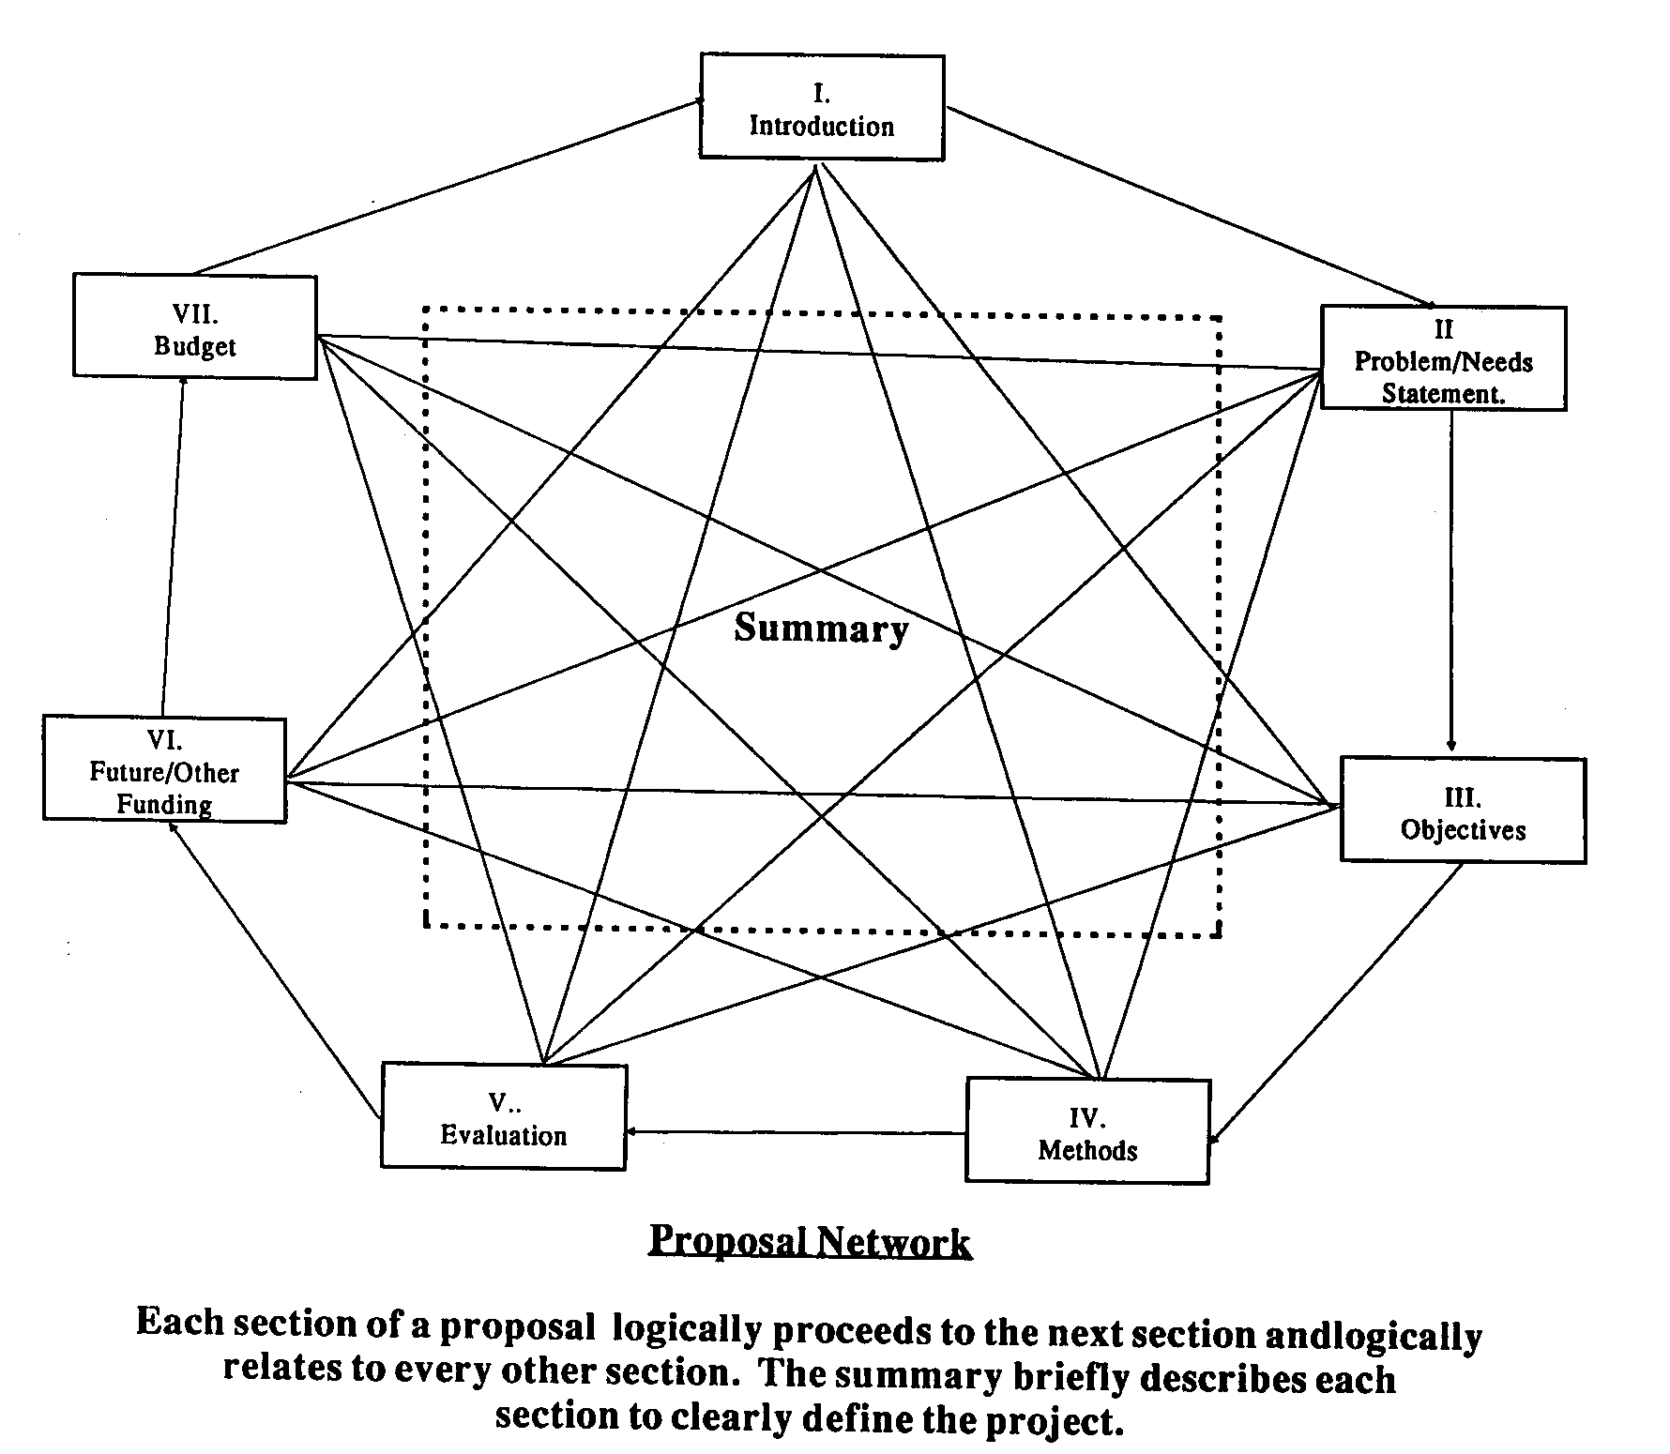
The Ultimate Goal of a Proposal
Abstract

Slide 26
Contact Information
Staff:
    Martin Williams, Director EXT 3263
    Lourdes Bastas, Assistant Director, Pre-Award Services EXT 3794
    Maureen Peters, Program Assistant EXT 2852
    Stephen Hahn, Associate Provost EXT 2565
Office:
    Raubinger Hall 309
    Fax: 973-720-3573
    Webpage:
    www.wpunj.edu/osp

