Slide 1
General IRB Issues Presentation
Martin Williams
IRB Administrator and
Director, Office of Sponsored Programs
William Paterson University
Discussion outline built on presentation
“The Human Subjects’ Protection Regulations and You: What Everyone Should Know”
by
Elyse I. Summers, Director
Division of Education and Development,
Office of Human Research Protections
January 19, 2011

Slide 2
Outline
History/Background
Ethical Principles
Shared Responsibilities
Key Points

Slide 3
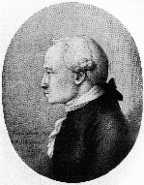
Philosophical Basis
Immanuel Kant (1724 - 1804):
“For all rational beings come under the law that each of them must treat itself and all others never merely as means, but in every case at the same time as ends in themselves.”
Notes:
Individual rights over collective (or state’s) rights.

Slide 4
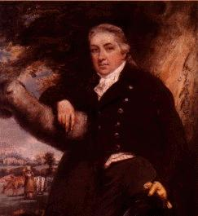
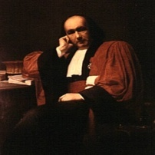
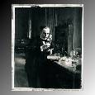
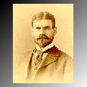
Pre WWII
Edward Jenner (England, 1789)
Smallpox Vaccine
Claude Bernard (France, 1865)
Vivisection research leads to Ethical Maxims
Louis Pasteur (France, 1885)
Rabies Vaccine
Walter Reed (United States, 1900)
Yellow Fever
Notes:
Research conducted by each of these investigators lead not only to important medical advances related to their specific interest but also provided new knowledge that was generalizable well beyond their specific interests.
Claude Bernard: Worked to establish scientific method as the way to conduct medical research. Was the first to offer the theory of Milieu Interiuer (internal environment) which was later proven and re-named Homeostasis. His major publication, An Introduction to the Study of Experimental Medicine established experimental method over observation and established the following ideas that have since come to be called his “Ethical Maxims:”
Facts over Theories (induction is always preferred over deduction, but deduction needs to come first to establish an hypothesis to be proved or disproved, and then follows to establish a new hypothesis to assist in moving the research forward).
Cause and Effect (in medicine)
Verification and Disproof
Determinism and Averages (qualitative analysis must precede quantitative analysis)
Truth over Falsification (all the data counts, not just what supports “your” hypothesis)
Discovery over Despising (desire to explore the unknown, don’t despise exploration of the unknown)

Slide 5
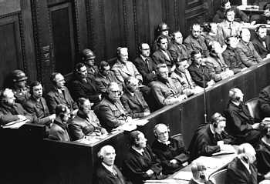
Nuremberg
During the Nuremberg
War Crimes Trials, 23
German doctors were
charged with crimes
against humanity for
“performing medical
experiments upon concentration camp inmates and other living human subjects, without their consent, in the course of which experiments the defendants committed the murders, brutalities, cruelties, tortures, atrocities, and other inhuman acts.”

Slide 6
The Nuremberg Code (1947)
As part of the verdict, the Court enumerated some rules for "Permissible Medical Experiments", now known as the “Nuremberg Code”. These rules include:
voluntary consent
benefits outweigh risks
ability of the subject to terminate participation

Slide 7

Declaration of Helsinki
Recommendations Guiding Medical Doctors in Biomedical Research Involving Human Subjects (1964)
“Concern for the interests of the subject must always prevail over the interests of science and society.”

Slide 8
Post WWII:
The Ends Continued to Justify the Means
Willowbrook (1950s)
mentally retarded children were deliberately infected with hepatitis
Jewish Chronic Disease Hospital (1960s)
Live cancer cells were injected into 22 senile patients
Milgram (1963)
"Behavioral study of obedience"
Humphries (1970)
Tearoom Trade: Impersonal Sex in Public Places
Henrietta Lacks (1951)
Use and distribution of medical specimens
Notes:
Willowbrook (1950s): mentally retarded children were deliberately infected with hepatitis virus
Jewish Chronic Disease Hospital (1960s): Live cancer cells were injected into 22 senile patients
Milgram (1963): "Behavioral study of odedience“
Henrietta Lacks (1951 to today): use of poor patients as un-informed research subjects; injustice of using someone’s cells without their knowledge for medical advances that enriched inventors and manufacturers and saved lives of those who could afford new medicines and procedures that did not benefit them or others who are similar to them

Slide 9
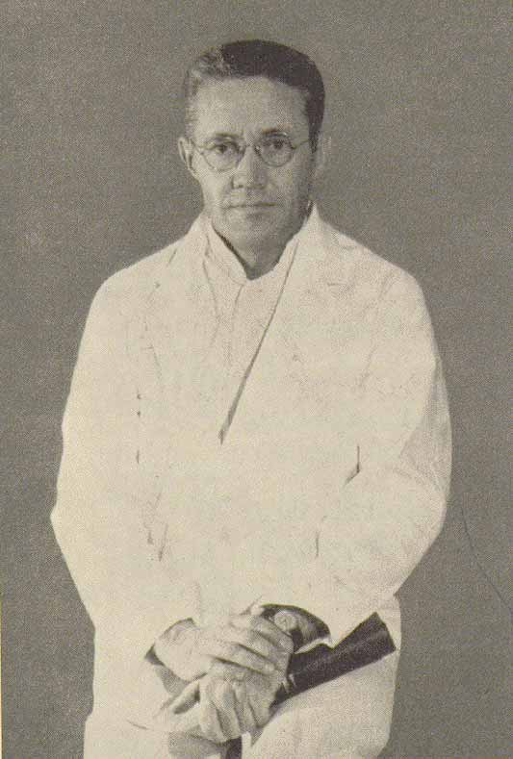
Beecher Article
“Ethics and clinical research”
Henry K. Beecher
New Engl J Med 274 (1966):1354-60
22 published medical studies presenting risk to subjects without their knowledge or approval
Published in some of the most prestigious journals and conducted at some of the most prestigious institutions

Slide 10
Public Health Service Policy
NIH Director and Surgeon General requested that the National Advisory Health Council review human subject protections
Council recommended prior institutional review for PHS supported research to:
  Protect the rights and welfare of the subjects
  Assure appropriate methods of informed consent
  Determine acceptable balance of risks and benefits
Adopted as Public Health Service policy in 1966
Beginnings of the Institutional Review Board (IRB)

Slide 11
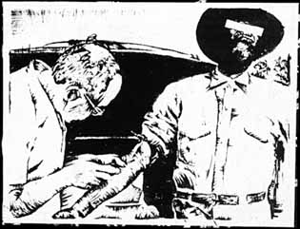
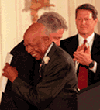
Tuskegee Syphilis Study
American medical research project conducted by the U.S. Public Health Service from 1932 to 1972, examined the natural course of untreated syphilis in black American men. The subjects, all impoverished sharecroppers from Macon county, Alabama, were unknowing participants in the study; they were not told that they had syphilis, nor were they offered effective treatment.
2011: Guatemala Syphilis Study (1932-1972) revealed

Slide 12
National Research Act
1973 Kennedy Hearings “Quality of Health Care - Human Experimentation”
1974 National Research Act
  Established the “National Commission for the Protection of Human Subjects of Biomedical and Behavioral Research”
  Required IRBs at institutions receiving HEW support for human subjects research

Slide 13
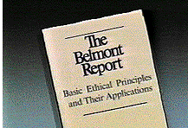
The Belmont Report
Ethical Principles and Guidelines for the Protection of Human Subjects of Research
The National Commission for the Protection of Human Subjects of Biomedical and Behavioral Research
April 18, 1979
Video: “Research Ethics,” Professor Robert Levine, Yale University, Aug 16, 2011
(http://www.youtube.com/watch?v=jD-YCDE_5yw)

Slide 14
The Belmont Report
Basic Ethical Principles:
Respect for Persons
  Individual autonomy
  Protection of individuals with reduced autonomy
Beneficence
  Maximize benefits and minimize harms
Justice
  Equitable distribution of research costs and benefits among subjects
The Belmont Report:
Text: http://ohsr.od.nih.gov/guidelines/belmont.html
Original Facsimilie: http://videocast.nih.gov/pdf/ohrp_belmont_report.pdf
Notes:
Ethics
Respect for Persons: Protection of autonomy and reduced autonomy (maturity; capacity); provision of voluntary consent and/or assent to participate; special issues with prisoners, people with communication disorders and language limitations.
Beneficence: An obligation to DO NO HARM while maximizing benefits and minimizing risks; process of finding the appropriate balance between risks and benefits; obligation is to both the individual and society, so balance becomes difficult; special issues with children’s health and education.
Justice: Why are you using the subjects you are planning to use? Is it the right pool or is it convenient and compliant? Does the research benefit the pool or another population? Who are you excluding from your pool and how might that impact them? Special issues in medical research that excluding populations as well as using a convenient population rather than the population that will benefit.
Applications:
Informed Consent: Each individual can decide what shall or shall not happen to them; enough information for each individual to make a reasonable choice about their participation; written in a way to allow effective comprehension (grade level, non-English language); voluntary – freely given without coercion or undue influence; repeated to insure that consent and understanding of the research and their role in it continues over the life of a multi-year/multi-contact project.
Assessment of Risks and Benefits: Nature and scope of research; probability of benefits vs. potential risks.
Selection of Subjects: Individual vs. Society; justice.

Slide 15
OHRP Oversight
All research involving human subjects conducted or supported by the Department of Health and Human Services (HHS) -- 45 CFR Part 46
Formerly known as the Office for Protection from Research Risks
Applies to both Biomedical and Social-Behavioral Research
Office of Human Research Protections
http://www.hhs.gov/ohrp/
Notes:
Two-tiered system:
Federal: Establishes ethical foundation, policies and guidance on practices. When research is funded by a Federal Agency, oversight of the research by that agency. Maintains register of local IRB’s and Certifies IRB’s. Federal efforts lead and coordinated by the Office of Human Research Protections which is located in the Department of Health and Human Services.
Local: Based on Federal policies and guidance, individual institutions establish their own local policies and procedures for reviewing, approving and overseeing research by their own IRB (Institutional Review Board) so that local practice is appropriate for the structure and culture of each organization. Agrees to follow the Federal policies and regulations as well as the specific rules of Federal (and other) research funding agencies.

Slide 16
Protecting Human Subjects is a Shared Responsibility
Institution
IRB
Investigator
Subjects
Research Team
Sponsor
Advocates
Family
Government
Public

Slide 17
Basic Responsibilities
Recognize when the regulations apply
Know your institution’s policies so that you can comply effectively
Obtain and document legally effective consent, assent, and parental permission

Slide 18
Responsibility #1
Recognize when the
regulations apply
to planned activities
45 CFR 46.101 and 102

Slide 19
Determining Applicability
Does activity involve research?
Does research involve human subjects?
Is the human subject research exempt?
Does the research involve a special class of subjects? (aka Vulnerable Population)

Slide 20
Examples of Investigator Activities: Is There Research Involving Human Subjects?
45 CFR 46.102(d), (f)
Obtaining information about living individuals by intervening or interacting with them
Obtaining identifiable private information about living individuals
Obtaining informed consent
Interacting with subjects
Studying, interpreting, or analyzing identifiable private information or data

Slide 21
Common Methodology Issues
Protection of Identity
  Anonymity
  Confidentiality
Online Surveys
  Recruitment, Products and Data
Third-Party Assistance
The IRB Hierarchy
  Site and source of subjects has last word

Slide 22
Exempted Research
45 CFR 46.101(b)(1)-(5)
Exempted Review: Less than minimal risk
  Normal educational practices in established educational settings
  Educational tests, surveys, interviews, or observation of public behavior unless identified and sensitive
  Research using existing data, if publicly available or recorded without identifiers
  Research on elected or appointed public officials or candidates for public office
  Evaluation of public benefit service programs
  Taste and food quality evaluation and consumer acceptance studies
Notes:
Time does not allow us to discuss Exempt Research categories in any great detail today, but we provide this overview slide for your future reference. If you have questions about exemptions, please ask us after the presentation or during the break.
A few points are worth pointing out regarding the Subparts:
All can be applied to subpart B (pregnant women, fetuses, & neonates)
Exemptions do not apply to prisoner research (subpart C)
Exemption 101(b)(2) does not apply to research with children except for research involving observation of public behavior when investigator(s) do not participate in the activities being observed.

Slide 23
Exempted Research
45 CFR 46.101(b)(1)-(5)
Social-Behavioral Research
Use with Special Classes of Subjects (Vulnerable Populations)
  All can be applied to pregnant women and fetuses
  Exemptions do not apply to prisoner research
  Exemption for children only applies to
    observation of public behavior when investigator(s) does not participate in the activities being observed
    pedagogical research by educators in their own classrooms

Slide 24
Expedited Research
45 CFR 46.102(i)
Expedited Review: No greater than minimal risk
  The probability and magnitude of harm or discomfort anticipated in the research are not greater in and of themselves than those ordinarily encountered in daily life or during the performance of routine physical or psychological examinations or tests.
Expedited Review: “The List” – and involves, e.g.,
  collection of limited blood samples;
  collection of data through physical sensors placed on body;
  collection of data from voice and other recordings, etc.
  non-IND, non-IDE studies originally reviewed by convened board and there determined to be no greater than minimal risk and no additional risks identified.

Slide 25
Provide sufficient information and materials
  Criteria for 46.111 determinations:
  e.g., risk/benefit ratio; appropriate recruitment; safeguards for vulnerable subjects (such as, avoiding coercion)
  Creates legally effective informed consent, assent, and permission materials
  Consider characteristics of local research
Recognize and manage conflicts of interest
  (e.g., disclose, reduce, eliminate)
Comply with IRB decisions and requirements
Respond to IRB requests in a timely fashion

Slide 26
Responsibility #2
Comply with relevant
Federal regulations
45 CFR 46

Slide 27
Regulations for Protection of Human Subjects
45 CFR 46
Subpart A – basic HHS Policy - “The Common Rule” is the common name for this policy that many other federal departments & agencies have adopted
Subpart B - Pregnant Women, Human Fetuses, and Neonates
Subpart C - Prisoners
Subpart D - Children
6
Notes:
Vulnerable Populations aka Special Classes of Subjects
Three subparts identify specific rules for these groups, but there are others that are not specifically identified, including those with diminished capacity and other subjects who may be open to coercion because of the research setting, research questions, the investigators relationship to them (such as employer/employee), or the possibility of the identification of their involvement and the resultant possible ramifications. Can include employees, patients, adult students, etc.

Slide 28
Responsibility #3
Initial Review
(45 CFR part 46.109(a)-(d); 46.110; 46.111)
Know Your Institution’s Policy and Processes for Submitting a Protocol

Slide 29
Does Your Institution Exempt Certain Kinds of Research from IRB Review?
“Federally Exempt” may not be reviewed
  Or some items may be reviewed but other items may not be
Institutions typically have SOPs to describe how and where and by whom exempt determinations are made
WPU: Pedagogical research, institutional research & assessment, and oral histories

Slide 30
What Materials are Required by Your IRB?
Protocol
  Form, narrative
Recruitment materials
Informed consent(s)
Data tools

Slide 31
How Does Your IRB Review and Approve Protocols?
Overall Process
  Committee member roles, Committee actions
  Differences between Exempted, Expedited and Full Review processes
Initial Review
Continuing Review

Slide 32
Responsibility #6
Obtain and document legally effective informed consent, assent, and parental permission in accord with §46.116, 46.117 and applicable subpart(s) and as approved by the IRB.

Slide 33
Informed Consent
Informed consent will be sought from each prospective subject or the subject’s legally authorized representative, in accordance with, and to the extent required by §46.111(a)(4); 46.116; 46.117
  Required unless IRB finds and documents that the criteria for a waiver or alteration of informed consent are satisfied
    Passive Consent: Completing a survey = consent to participate
    IRB Decision for Subjects: Observation of public behavior
  IRB may require written statement be provided to subjects
  Written in language appropriate to subjects
Notes:
Consent vs. Waived Consent: aka Active Consent vs. Passive Consent.
Consent/Active Consent: When the subject signs the informed consent document to state their agreement to participate.
Waived/Passive Consent: (a) When the subject chooses to participate without signing the consent statement (i.e.: completing a survey without identifying themselves to protect their anonymity. (b) When the IRB proves consent for the whole group of subjects, such as for public observation.

Slide 34
The Consent Process
Use currently approved informed consent document
“Re-consent” as appropriate in studies with multiple contacts or over multiple years
Provide copy to subject
  Copy to witness, other as needed
Subpart D –
  Child Assent
  Parental or guardian permission
Notes:
Comprehension, voluntary, repeated as needed
Child assent
when capable of providing assent
waiver under circumstances permitted by §46.116
Parental or guardian permission
to extent that consent is required by §46.116 and
in accordance with §46.408
whether one or both parents - depends on category of permissible research

Slide 35
Key Points
Follow Belmont Report, Federal regulations, IRB & institutional procedures and policies
Promptly report changes or problems to the IRB
Obtain, document, and retain legally effective informed consent
Ensure ongoing protections

Slide 36
Sources of Additional Information and Guidance
OHRP website: www.hhs.gov/ohrp
OHRP listserv: for instructions on signing up, see website
OHRP telephone (toll free): 1-866-447-4777
OHRP e-mail: ohrp@hhs.gov

Slide 37
Martin Williams
  Director, Office of Sponsored Programs
  Administrator, WPU Institutional Review Board
  William Paterson University
  300 Pompton Road
  Wayne, NJ 07470
  973-720-2852
  williamsm@wpunj.edu
www.wpunj.edu/osp/irb

