Slide 1
Proposal Writing workshop
Office of Sponsored Programs
November 2011

Slide 2
Agenda
Focus on What is Important
Proposal Structure
Proposal Development Process
Proposal Review

Slide 3
Focus on What is important
Agencies and their divisions
  Vision, goals, priorities, general policies
  General administrative regulations for proposal development and project management
  Forms, electronic systems
  Funding program guidelines

Slide 4
Previous Work and Experience
  Know yourself and your situation
    How innovative is your work and ideas compared to your peers?
  Previous project or research
    Whether or not you were the lead person
  Preliminary data
  Publications
  Plans for future activity and/or research

Slide 5
Select appropriate funding programs
  Know yourself and your situation
  Preliminary work, initial brief summary or more detailed outline (depends on state of project)
  Identify, examine, select and prioritize possible funding programs
    Program goals, areas of interest, types of support, eligibility requirements, size of awards, application process, submission deadline, project dates

Slide 6
Study selected programs and submission requirements and methods
  Program guidelines, proposal and submission guides
  3rd Party analysis of program/guidelines
  Conversation with OSP
  Study award lists, abstracts, full proposals

Slide 7
General review criteria
  Intellectual quality and merit
  Potential (broad) impact
  Innovation
  Outcome expectations and dissemination/sharing
  Agency checklists or forms
  Reviewer comments from same agency for funded and not-funded proposals

Slide 8
Specific review criteria
  Broad agency and division goals, mandates and review criteria
  Funding program goals, objectives and review criteria
    General
    Specific
  Program officer comments and insights
  Scoring system

Slide 9
Study and understand review processes
  At WPU before submission
  At agency after submission
    Technical review
    Peer review
    Division review
Prepare 2-paragraph description of project based on original idea + understanding of funding program goals

Slide 10
Writing exercise
Write a 1 paragraph description of your idea.

Slide 11
Conversation with program officer
  Technical Assistance Workshop by funding agency
  Phone, email: Proposal director with OSP as desired
  Compatibility, appropriateness and details related to the proposed project
  Technical and format issues

Slide 12
Proposal structure
Four broad proposal component groups
  Introduction to you and your project
    Cover sheet, abstract/summary, required forms
  Narrative
    Background, needs, benefits, credibility, goals, activities, personnel, evaluation/assessment, dissemination, etc
  Budgets
    Summary, detail, subcontracts
  Attachments
    Required, voluntary

Slide 13
Proposal development process
General process
  Idea development & preliminary activity
  Grant program analysis
  Create first draft, then review, expand and fill in
  Prepare subsequent drafts, review and edit as needed until final components are ready
  Complete forms, assemble sections for submission
  Institutional review, complete requested modifications, and submit

Slide 14
Work in an organized manner appropriate to your personal style
Respect deadlines
Self edit and give to others for review and comment

Slide 15
Sample narrative sections
Reading Order
Summary
Background/credibility
Problem
Objectives
Activities
Dissemination
Evaluation
Future Activity
Budget
Writing Order
Activities AND Budget
Objectives
Problem
Background/credibility
Evaluation
Dissemination
Future Activity
Summary

Slide 16
Sample budget sections
  Summary
    Category subtotals and grand total
    Request and matching
  Justification
    Narrative or detailed spreadsheet, all expenses
  Categories
    Personnel, fringe, travel, equipment, supplies, contractual (includes subawards), participant support costs, construction, other expenses, indirect

Slide 17
The Proposal Network
Insert spider web

Slide 18
Proposal review
Funding program agency review by
  Program managers, other administration
  Outside reviewers
  Peer review panels
Peer or experienced readers by
  Knowledgeable colleagues at WPU
  Mentors and knowledgeable colleagues not at WP
  Deans, Department Chairs, Sponsored Programs, Provost’s Office

Slide 19
Other WPU administrative review
  Compliance oversight committees
    Federal or state regulations, such as IRB or IACUC
  Special Needs
  Budget
    OSP, Business Services: are expenses allowable and appropriate for the project?
  Impact on the University
    Mission, goals, objectives, fit with academic or other existing programs and appropriate to project

Slide 20
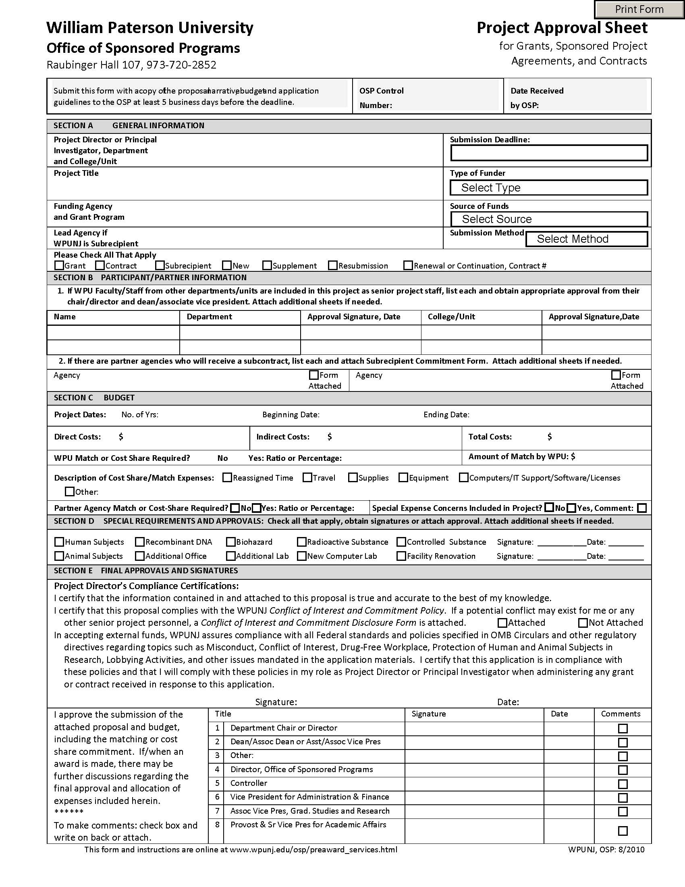
Project Approval sheet
Sections
  A. General Information
    Applicant, Sponsor, Deadline, Submission Method, Type of Award
  B. Participant/Partner Information
  C. Budget
    Request, Cost-Share
  D. Special Requirements
  A. Final Approvals and Signatures
    Certification to comply
    Certification to support

Slide 21
Questions
Concerns
Schedule meeting to talk about your proposal

Slide 22
Office of sponsored programs
Martin Williams, Director
  williamsm@wpunj.edu
Lourdes Bastas, Assistant Director for Pre-Award Services
  bastasl@wpunj.edu
309 Raubinger Hall
973-720-2852

