Slide 1
Effort Reporting at William Paterson University:
An Introduction and User Guide
Martin Williams
Director, Office of Sponsored Programs
973-720-2852; WilliamsM@wpunj.edu
Notes:
William Paterson University
Effort Reporting System User Guide
This guide is based on the Effort Reporting Workshop PowerPoint Presentation and the conversation and questions that have typically been part of the workshop.
September 2012

Slide 2
Agenda and Table of Contents
Effort Reporting at William Paterson Pg. 2
Requirements and Implementation Pg. 8
How and When Effort is Reported Pg. 9
Notes:
  Effort Reporting and Effort Certification are synonyms, as are PI/Principal Investigator and PD/Project Director, and are used as such throughout this presentation and user guide.
  “Time” and “Effort” are not synonyms.
    Time is the number of hours worked
    Effort is what was done during those hours.
  Effort Reporting is required for all staff who are working on a project.
Notes:
This User Guide is an expanded version of the workshop presentation that is offered by the Office of Sponsored Programs.
Use this Guide to answer basic questions concerning what information is required and the frequency of reporting as well as to review the requirements and expectations surrounding the William Paterson University Effort Reporting policy and process.
Questions are always welcome and are heartily encouraged.
Contact Information:
Office of Sponsored Programs
Raubinger Hall, Room 309
973-720-2852
Martin Williams, Director
Cleavens Estriplet, Post-Award Coordinator

Slide 3
1. Effort Reporting at William Paterson
Effort Reports and Timesheets are Not The Same
  Effort Reports record activities and the percentage of an employees' effort expended on a project.
  Timesheets document the total number of hours worked for payroll purposes (amount of compensation, vacation and sick time accrual and usage, etc.).
  The value of someone’s effort is based on the compensation agreement between that person and their institution multiplied by the percentage of his/her time on the project.
    Value of Effort = Percentage of Effort x Salary or Wages
  The allocation of someone’s effort toward one or more funding sources is known as payroll distribution.
“I Love Effort Certification” (YouTube)
    http://youtu.be/9LEKjVdYN6g
Notes:
Effort reports document everything that you do for the University – your personal effort expended on our behalf. Effort includes regular assigned duties AND additional duties such as teaching overload or teaching as an adjunct or advisement or an administrative assignment or working overtime or earning compensatory time. All of this activity together represents 100% of your effort for the University. On any given day, you cannot provide more than 100% of you effort and you cannot provide more than 100% of your effort in any given 12-month period.
There are few exceptions to this rule. Attending or leading a professional development workshop on campus is an example of this. When the University pays you for your time for something that is outside of the activities the scope of your regular duties AND it is of limited in length or a short duration, this is considered an extra activity that is not included in your 100% time.
The value of your effort is computed based on the percentage of time that your effort represents multiplied by your salary or wages. For example, if you are working on a project and spend 10 hours of a 40-hour work week on a project, your have expended 25% of your effort for the University on that project. If your salary is $40,000, then the value of your effort is $10,000. It is important that timesheets and FLMs “balance” with the hours and levels of effort reported here. (FLM = Faculty Load Module)
There are two important pieces of information to remember here: (1) No one’s effort can exceed 100% even if that effort represents 5-hours or 50-hours in a week. (2) Effort is averaged over time because the amount of effort someone expends on a project may fluctuate from week to week or month to month – at WP, we call this “annualized effort.”
The URL for the “I Love Effort Certification” is http://www.youtube.com/watch?v=9LEKjVdYN6g.

Slide 4
Effort Reporting: Top 10 Things a P.I. Should Know
Robert C. Andresen, Assistant Director Research And Sponsored Programs, University of Wisconsin – Madison
National Council of University Research Administrators, September 8, 2011
Effort Reporting
Effort Reporting is our means of providing assurance to sponsors that:
1. Salaries charged to a sponsored project is reasonable in relation to the work performed, and
2. Faculty and staff have met their commitments to sponsored projects.
Success in the effort realm depends on careful attention to important issues throughout the sponsored projects lifecycle and communication among all the people involved.
Notes:
The Level of Effort that a sponsor expects is based on the projection that established in the cost or budget section of the project’s proposal, contract or the most recent modification. If the proposal predicted 25% of someone’s effort, the sponsor will expect us to be able to document that 25% of someone’s effort was expended for the project.
The amount of compensation that someone receives for the effort that they expend on the project should be based on their regular salary and wages and be considered within the compensation they receive for their effort.
“Overtime” and “Overload” are not allowed to be paid with a sponsor’s funds unless there was a specific written directive that this is allowable.

Slide 5
1. Effort is your work on a project, whether the sponsor pays your salary or not.
2. When you write yourself into a grant proposal, you are committing your effort to the sponsor.
3. If you reduce your effort, paid or unpaid, on a federal grant by 25%, you must have agency approval. If you reduce your paid effort, you may choose to document cost-sharing so that the total effort does not decrease.
4. Many activities cannot be charged to a federally sponsored project. For example, the time you spend on these activities cannot be charged:
  ¤ Writing a proposal
  ¤ Serving on an IRB, IACUC or other research committee
  ¤ Serving on a departmental or university service committee
Notes:
When the University commit to sharing part of the cost of the overall project and this is included in the sponsors award, and if part of that commitment is someone’s effort on behalf of the project, then that effort must be documented. Whether this commitment is called cost sharing, matching or in-kind, the requirement to document is the same.
The proposal establishes the level of effort and its value and is a commitment from the moment the proposal is submitted. 100% effort in a proposal DOES NOT mean 80% on the project and 20% on additional activities when the award is received. If there is an expectation that a 100% effort person will go towards teaching as an adjunct then the correct effort on the proposal for the project may be 90% paid by the sponsor and 10% paid by the University.
Changes in the level of someone’s effort must be reported to the sponsor along with a mitigation plan or a request to either decrease or increase the effort commitment. This holds true for both sponsor-funded or University contributed effort.
A sponsor will not compensate someone for writing a proposal that seeks additional funds from them to continue the project. A sponsor cannot compensate someone for effort they expend on something other than their project. These expenses must be paid by the University and cannot be included as cost sharing since it is an unrelated activity. This also cannot reduce the level of effort committed to the project.

Slide 6
5. If you work on a sponsored project, you must certify your effort.
6. Certifying effort is not the same as certifying payroll.
7. Certification must reasonably reflect all the effort for all the activities that are covered by the University’s compensation.
8. Effort is not based on a 40-hour work week. It’s not based on hours at all even though hours are used to help estimate effort.
9. Effort must be certified by someone with suitable means of verifying that the work was performed.
10. In identifying audit findings, auditors look for indications that certification was based on factors other than actual, justifiable effort.
Notes:
5, 6, 7 and 9: Effort must be documented by the person who expended the effort and certified by someone who is familiar with that person’s activities. Since payroll and effort reporting are separate processes using separate forms, certifying one is not the same as certifying the other.
8: Level of effort represents that actual amount of effort expended against all the effort provided to the University. For example, if you provided 5 hours of effort on a project in one week and did nothing else for the University on that week, those 5 hours would constitute 100% of effort for that week. In the same way, if you provided 60 hours of effort on a project in one week and did nothing else for the University on that week, those 60 hours would constitute 100% of effort for that week.
10. Since payroll costs are the largest expense in virtually all sponsored projects, and since there is a history of poor effort reporting by universities in general, auditors generally begin examining a project’s financial records by analyzing effort reports. Since audits typically take place long after an award has been closed-out, if the effort reporting on a project is found to be deficient and a judgement is made against the University, then William Paterson University is required to pay this out of its own funds. Whether this is $200 or $200,000, it is important that we work to avoid this situation.

Slide 7
Review
  Talking with your faculty about effort reporting, part 1
    The Three Mantras of Effort Reporting
    http://youtu.be/dpkXqQ38m84
  Talking with your faculty about effort reporting, part 2
    http://youtu.be/yNDQX1TezbQ
            YouTube Videos: © National Council of Research Administrators, 2011
  Time and Effort Reporting Procedures, Denton Independent School District, Denton, TX
    http://youtu.be/HsOhU4lBGpk
Notes:
3 Mantras of Effort Reporting
100% is 100%
There are no nights and weekends
All activities must show up
Unsure How this Works? Add It Up
Make a list of activities during an “average” week
Assign hours, add them up and divide: H = Total Hours, A = Activity Hours
Total Hours / Activity Hours = % of Effort for Activity
Why are we doing this? To fulfill a Federal Requirement.
The Denton TX School District’s system described here is NOT the same as William Paterson’s, but it has many similarities and is a good lesson that:
All institutions receiving funds that support personnel have to do it
All institutions decide how they will accomplish collecting it
There are standard “pieces” of information that must be collected.

Slide 8
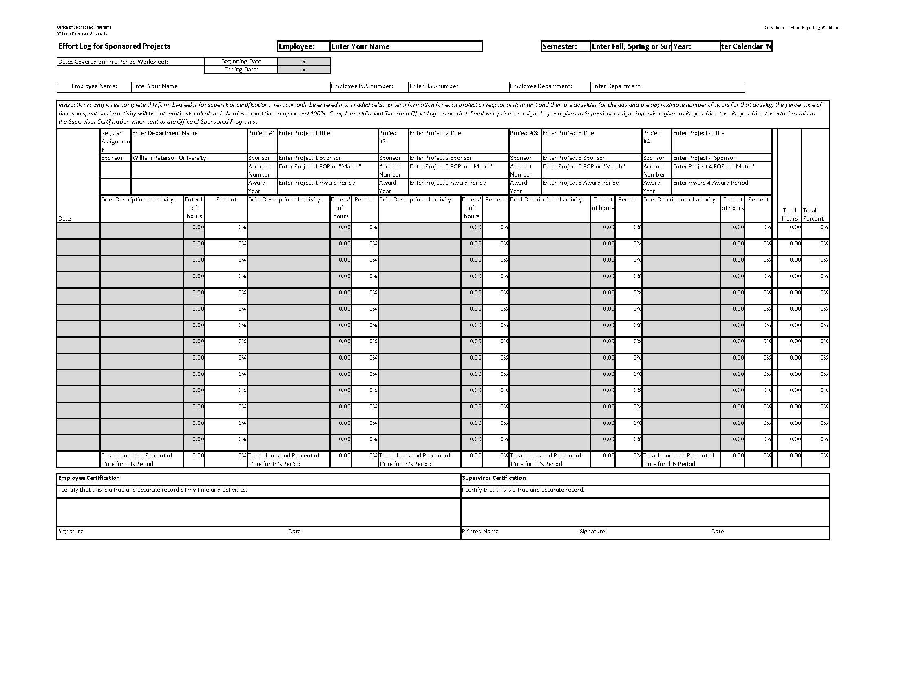
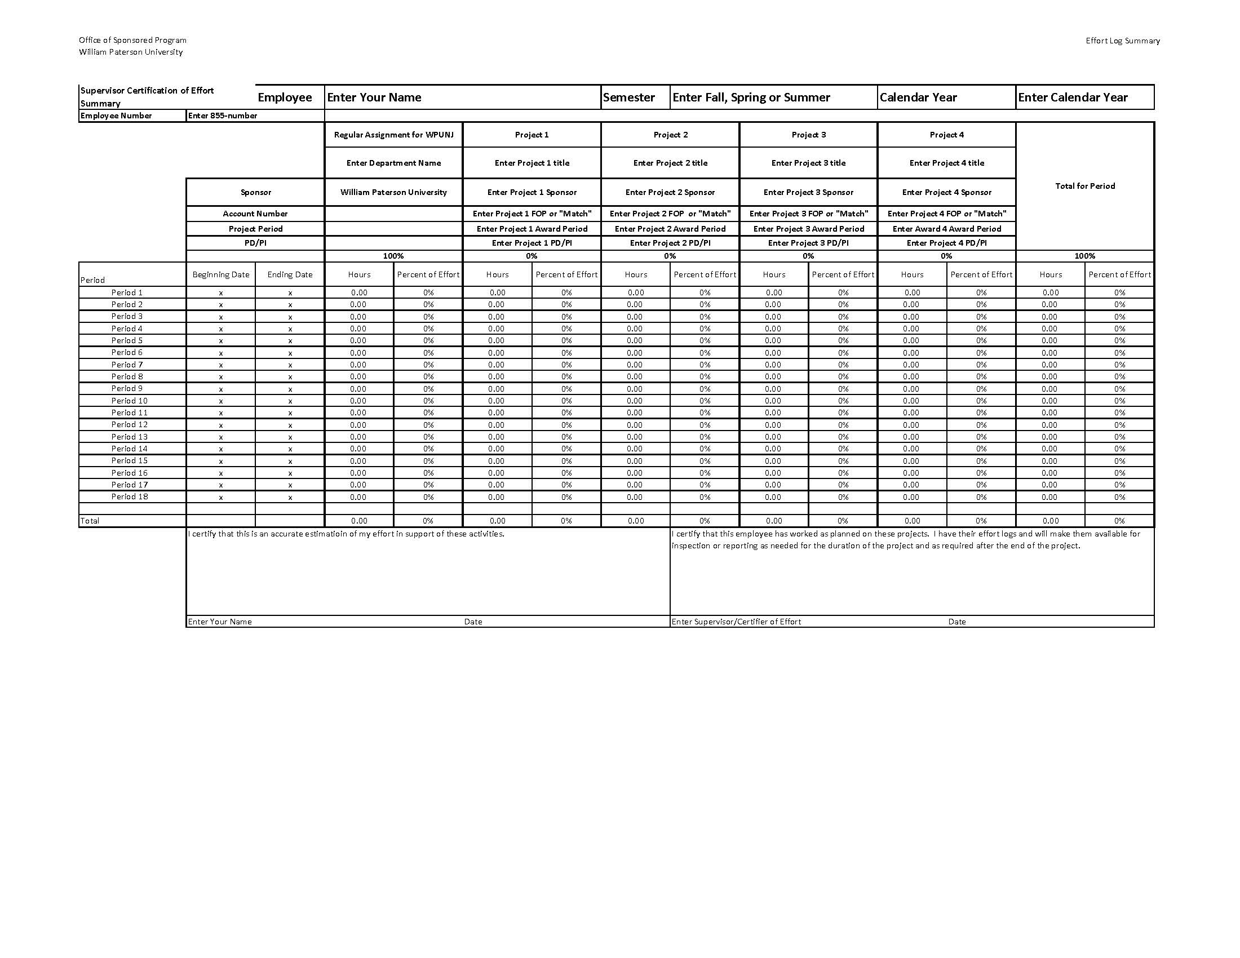
Two Forms
Effort Log for Sponsored Projects: Employee and Supervisor, generally biweekly or monthly.
Effort Log Summary and Certification: Employee and Supervisor, 3 times per year (Jan, June, Sept)
Notes:
These are the two key documents that William Paterson University’s Effort Reporting system is based on.
1. The Effort Log for Sponsored Projects is completed on a regular basis by the person who is required to provide their to a sponsored project. Once this is completed, it is provided to their supervisor for certification. The Consolidated Effort Reporting Excel Workbook can accommodate up to 18 bi-weekly periods.
2. The Effort Log Summary and Certification form is completed automatically when an Effort Log is initiated in a Consolidated Effort Reporting Excel Workbook. Three times each year, the summary is printed, signed by the employee and his/her supervisor, and then forwarded to the Office of Sponsored Programs. After this report is generated, the employee opens and initiates a NEW Consolidated Effort Reporting Excel Workbook.
A significant amount of the information included on these forms is automatically filled when the Project Set-Up Page is completed.
Schedule:
Fall Semester (September to December) Due January 15
Spring Semester (January to May) Due June 15
Summer Semesters (June to August) Due September 15

Slide 9
2. Requirements and Implementation
Effort Reports are Required by Sponsors
  OMB Circular A-21 (2 CFR Part 220 Appendix A.J.10)
  Long-standing requirement
Method previously used by WPUNJ proved to be insufficient
  “Plan Confirmation Method”: Level of effort is proposed in the application for funding then the provision of effort is later confirmed by the employee and her/his supervisor.
  Inadequate training and understanding of roles, requirements and application of effort mixed with inadequate documentation and inadequate oversight created an opportunity for unintentional and inappropriate activities.
  Increased sponsor scrutiny, possibility of audits and potential penalties encouraged this “corrective action” by WPUNJ before it could be imposed upon us.
Notes:
Documenting effort has been a long-standing requirement for Federal and State grants and contracts. Until 2010 when it was determined to be significantly inadequate, WPU relied solely on timesheets to document effort. This system does not rely on timesheets. It collects information specifically related to the effort that employees give to the various projects that pay their wages. This WP effort reporting system meets all of the requirements of an adequate system.
Recalling the 10th item in Effort Reporting: Top 10 Things a PI Should Know as well as notices from sponsors that the number of audits conducted annually will increase, the William Paterson is committed to reducing the threat of “corrective action” judgments by sponsors that could cost tens of thousands of dollars and have a negative effect on our ability to receive funding.

Slide 10
3. How and When Effort is Reported
WPUNJ Effort Reporting Policy and Procedures
  OSP Website: www.wpunj.edu/osp > Funded Project Support
  Section 3: Step by step description (page 5)
Overall Process:
  Hiring/Assignment of staff: PCF/HRAF created to hire or updated as needed to indicate percentages when charged to award
  Timesheets / FLMs completed and submitted as required.
  Effort Logs completed, signed and certified
  Supervisor certification and submission of Effort Summary
  PI/PD certifies effort related to his/her project(s)
  OSP maintains PI Certified summaries, shares them with Business Services, and “annualizes” effort
Notes:
Information on the Effort Reporting Policy as well all the forms and this user guide are available on the Office of Sponsored Program’s website.
The overall process has three basic areas of activity:
Hiring and Compensation: This includes all of the steps and forms required to hire an employee, receive timesheets or FLMs, and managing sick, vacation and other accrued and used time.
Employee/Supervisor Certification: This includes the completion and certification of the Effort Log Worksheets and the completion, certification and delivery of the Effort Summary to the Office of Sponsored Programs.
PI Certification and use by OSP and Business Services: The PI must certify that the level of effort provided by each person is in accordance with the level that the sponsor expects (see page 4). If it is not, then a corrective plan is developed by the PI, the employee and the OSP so that the level of effort can be the same as the commitment. If this is impossible to achieve, the PI and the OSP will petition the sponsor to change the level of effort (and possibly re-budget funds). When preparing financial reports, Business Services compares the compensation each individual received to the to the commitment to insure that all payments were proper.
The term “annualized effort” refers to the process of averaging effort over an award period. As previously discussed, the amount of actual effort expended on a project can fluctuate from week to week, month to month, and semester to semester. Sometimes this is planned (eg: expanded activity during the summer) but mostly that is just part of the life of a project. When Summary Reports are received, they are compared against both the annual percentage commitment as well as the activities that have already occurred and that will occur in future periods to determine if the level of effort is likely to be met.
Example: WPU receives an award to present a conference at the end of a Spring Semester. Most of the work leading up to the conference will be performed during the Spring Semester, and the proposal estimates 25% of the Project Coordinator’s effort will be needed. In the Fall Semester, the Project Coordinate spends so little time on the project that she/he reports zero percent ( 0% ) effort. Then in the Spring, she/he reports 50% effort on the project. The average level of effort provided to the project is 25% and meets the University’s commitment.

Slide 11
People and Offices Involved
Project Staff:
  5.1% to 100% on project, FT or PT, award funded or WPU match/cost-share: Complete & sign Effort Logs; print & sign Summaries
  5% and less on project: Complete Limited Effort Certification
Supervisors: Do not need to be involved in project
    Sign & keep Effort Logs; sign & forward Summaries
Project Directors/Principal Investigators
    Certifies project staff’s effort on the project; Monitors “annualized” Effort
Office of Sponsored Programs
    Receives Summaries; obtains PD/PI certifications; shares with Business Services; maintains originals in project file; monitors “annualized” effort
Office of Business Services
    Uses in report preparation
Notes:
These are the responsibilities and activities of each individual involved in reporting or certifying effort.
If an individual is expected to provide 5 percent or less of their effort to a project, they complete the Limited Effort Certification form, it is signed by the project director, and then forwarded to the OSP for processing with other Effort Report Summaries.

Slide 12
Steps to Complete Effort Log
Download and save Consolidated Effort Reporting Workbook (Excel)
  OSP webpage
  Workbook includes:
    Instructions and Set-Up
    Timeline and FAQ
    Summary and Certification
    Effort Logs
    Sample Set-Up, Effort Logs and Summary tabs
Notes:
To open a new Consolidated Effort Reporting Workbook, go to the OSP Website and click on the link for managing an award. Scroll down to the section on Effort Reporting. “Right Click” on the link for the Workbook, save it in My Documents, and then open the workbook. The Workbook has four sections:
Tab 1: Instructions and Set-Up: This provides information on how to use the workbook and an area where information on sponsored projects or activities is entered. This information is automatically posted on the other worksheets (or tabs) in the workbook.
Tab 3: Summary and Certification: This is the page that is automatically filled when information is added to in Set-Up or the Effort Log Worksheets, then printed, signed by the employee and her/his supervisor and then forwarded to the OSP.
Tabs 4 to 22: Effort Log Worksheets. These are completed either bi-weekly or monthly, are printed and signed when completed, and are then given to the employees supervisor to sign and saving.
Tabs 23 to 26: Sample Set-Up Page, 2 Sample Effort Log Worksheets, and a Sample Summary and Certification form.

Slide 13
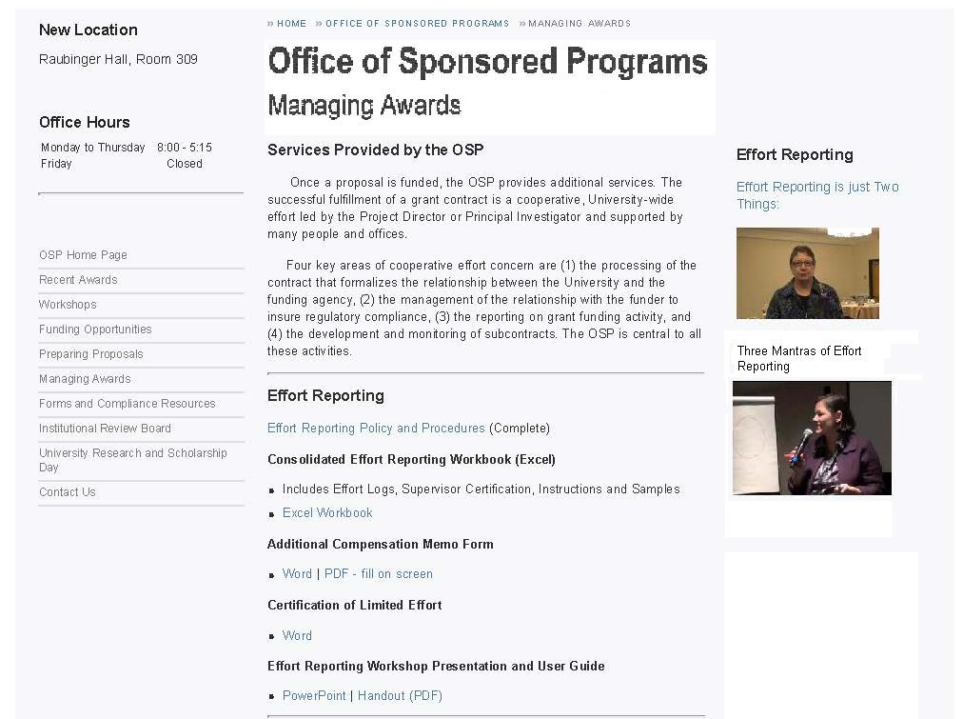
Informative Videos
Insert Webpage with instruction blocks
Effort Policy
Workbook: Click to save on user drive each time starting new workbook.
Additional Compensation: Save or use from here each time.
Certification of Limited Effort
Presentation & User Guide
Notes:
This is the OSP’s Managing Awards webpage. The page has the Effort Reporting Policy, the Consolidated Effort Reporting Workbook, the Additional Compensation and Certification of Limited Effort memorandum, the current edition of the Effort Reporting Workshop PowerPoint presentation, and the User Guide.
Screen shot created September 7, 2012.

Slide 14
Project List/Set-Up: Complete this first
  Defines project specifications
  Information will be loaded onto Effort Logs and Summary
  Provided by PI’s to project staff or created by project staff
  “Regular Assignment” is default first “project”
  For each project:
    Enter Project Title
    Enter Sponsor (funding agency)
    Enter FOP
      If WPU-funded, enter “Cost Share” or “Match”
    Enter Annual Award Period
    Enter Effort Commitment
    Enter Name of Project Director/Principal Investigator
Notes:
This information defines the employee’s effort commitments to the University and to each sponsored project. Enter the information that is requested in each line.
Not many at the University will be engaged in more than two or three projects or activities. If this is your situation, delete the instructions in the cells that are not needed. Even fewer individuals will be engaged in more than their regular assignment and four sponsored projects. However, if someone is, they should contact the OSP for a customized workbook.
If you do not know the FOP for a sponsored project, complete the other information and leave the FOP blank.
If a multi-year project’s anniversary date is during a period, enter the first year as one project and then enter the second year as a second project. When the anniversary date comes up on one of the Effort Log Worksheets, stop entering for the first year on the appropriate date and then begin entering for the second year on the next day.

Slide 15
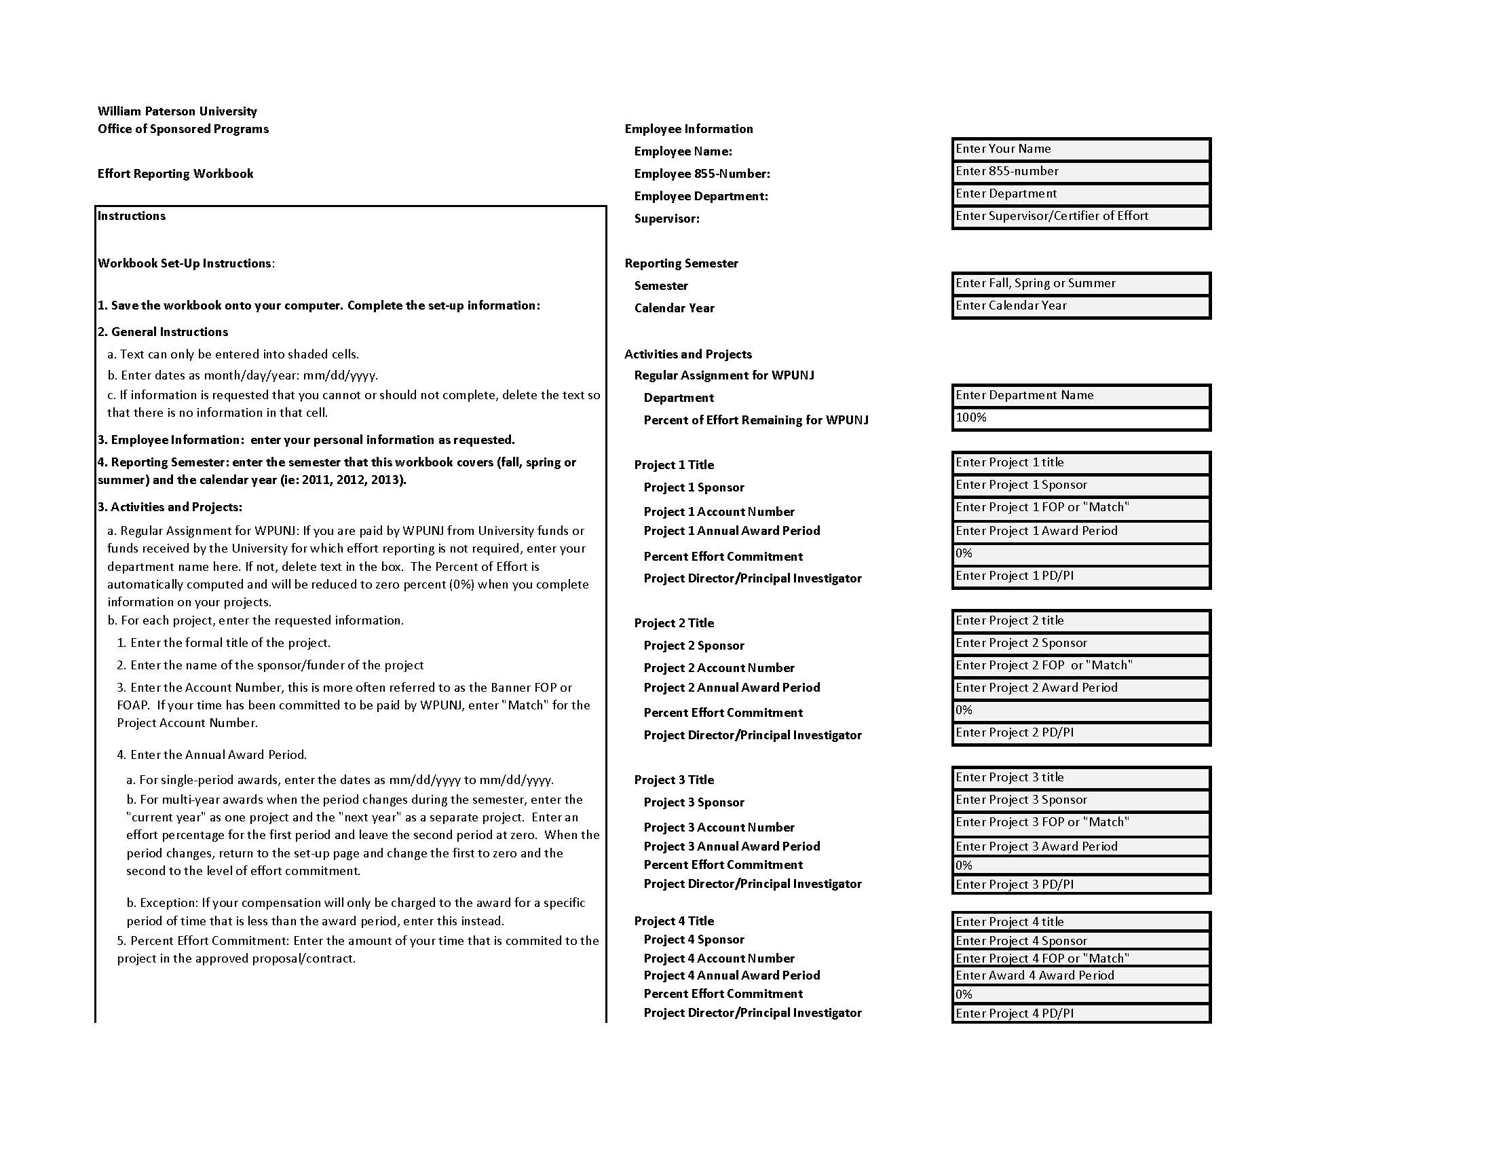
Enter your information
Enter your department’s information. If 100% on award, enter as if project.
Set-up page with instruction blocks
Enter information for each project. If more than four, call OSP so that we can create a customized form for you. For surplus boxes, delete instructions so that they are blank.
Enter Banner Finance FOP for each project. Obtain from PD/PI. If match, enter “match” as FOP.
Notes:
Employee Information
Enter your name, your 855-number, where you are assigned, who you report to.
Reporting Semester
Enter the period of time covered by the report: Fall (September to December), Spring (January to May) or Summer (June to August).
Regular Assignment for WPUNJ
If you are at least partially funded by WPU should provide the name of the Department to which he/she is assigned.
If you are entirely funded by external funding should delete the information for “Department” so that it is blank.
Projects
Enter information on the projects that you are working for: the title of the project, the Sponsor (funding agency), the account number for the award (the FOP if you know it), the annual award period (December 1, 2010 to November 30, 2011), the level of effort that is expected of you (10%, 50%, 100%), and the name of the project director/principal investigator who is responsible for the award.
If your effort on behalf of the project is being paid for by the University, for the account number enter MATCH.
If you do not need all four projects, delete the information so that all the cells for those projects are blank.
If you are involved in more than four projects, contact the Office of Sponsored Programs, ext 2852.

Slide 16
Effort Log: Complete at least monthly but bi-weekly probably the most convenient
  Enter Beginning and Ending Dates for Period
  Enter dates for each day worked
  Enter brief description of work for each day worked for each project, including “no activity”
  Enter approximate number of hours worked for each project
  Percentage of effort automatically computed
  Print, sign and submit to supervisor for signing and filing
Notes:
This is the Effort Log, it is the most important of the two forms that comprise the William Paterson Effort Reporting system.
This form collects the documentation of your effort on behalf of the University and the projects you are engaged in, and it “feeds” hours and percentages of effort to the Supervisor Certification of Effort Summary.

Slide 17
Enter dates covered by this specific spreadsheet.
Information from Set-Up Page will populate employee information, period, headings and names.
Insert Effort Log with instruction blocks
Enter date, brief descriptions and approximate time for regular duties and projects.
Effort will compute and always total to 100%
Effort and hours will total for activity; transfers to summary.
Print, sign to certify. Give to Supervisor to certify and hold.
Notes:
There are 18 Effort Log Worksheets that can be completed at least monthly but no more than bi-weekly (twice/month). The 18 worksheets match the longest of the three reporting periods, January to May, if bi-weekly Effort Logs are prepared.
Information that will be automatically transferred from the Set-Up includes: Your name, the semester and year, regular assignment, and from each project.
Information you must enter: Beginning and Ending Dates for the Effort Log, and the date, description of activities and the number of hours for those activities.
Date: Enter as mm/dd/yyyy. Can be for one day or for a longer period; if it is for a longer period, such as a week, begin the description with “For Week Ending, …”
Description: In 40-characters or less, describe the activities for that project for the period covered by the date. While more than 40 characters can be typed into the cell, only 40 characters will be seen when the Effort Log is printed.
Hours: Enter the approximate length of time spent on this activity as hours and minutes in decimal format: 1.5 = 1 hour, 30 minutes. Do not use any time increments less than 15-minutes (.25). The Effort Reporting system is based on averages; those minutes will average over time for an accurate record of your effort.
Multiple Projects: All the activities for all the projects you are involved should be on the same date line.
Total hours and percentages of effort will compute automatically for each date (row) and for each project (column) and will transfer to the Summary sheet.
When an Effort Log has been completed, print it, sign it, and give it to your supervisor to sign and keep.

Slide 18
3. Effort Log, continued:
Activity diary:
  Use to create and substantiate descriptions of activities on the Effort Log
  Any format that is right for the employee as long as activities are clear, are assigned to a specific project, and are prepared in a timely manner.
Notes:
Everyone keeps some kind of diary of their activities, which can range from “to do” lists to digital assistants to notes to meeting schedules in MS Outlook. Whether it is paper or electronic, there is a record somewhere. These records can provide the information needed to both accurately describe activities on the Effort Log and to provide additional documentation of your activities if required. WPU does not require a particular format, nor do we require that you keep a diary at all, but we do strongly encourage you to have some type of record so that you do not need to completely rely on your memory when you are completing an Effort Log.
Some projects have detailed activity logs. These are excellent diaries.

Slide 19
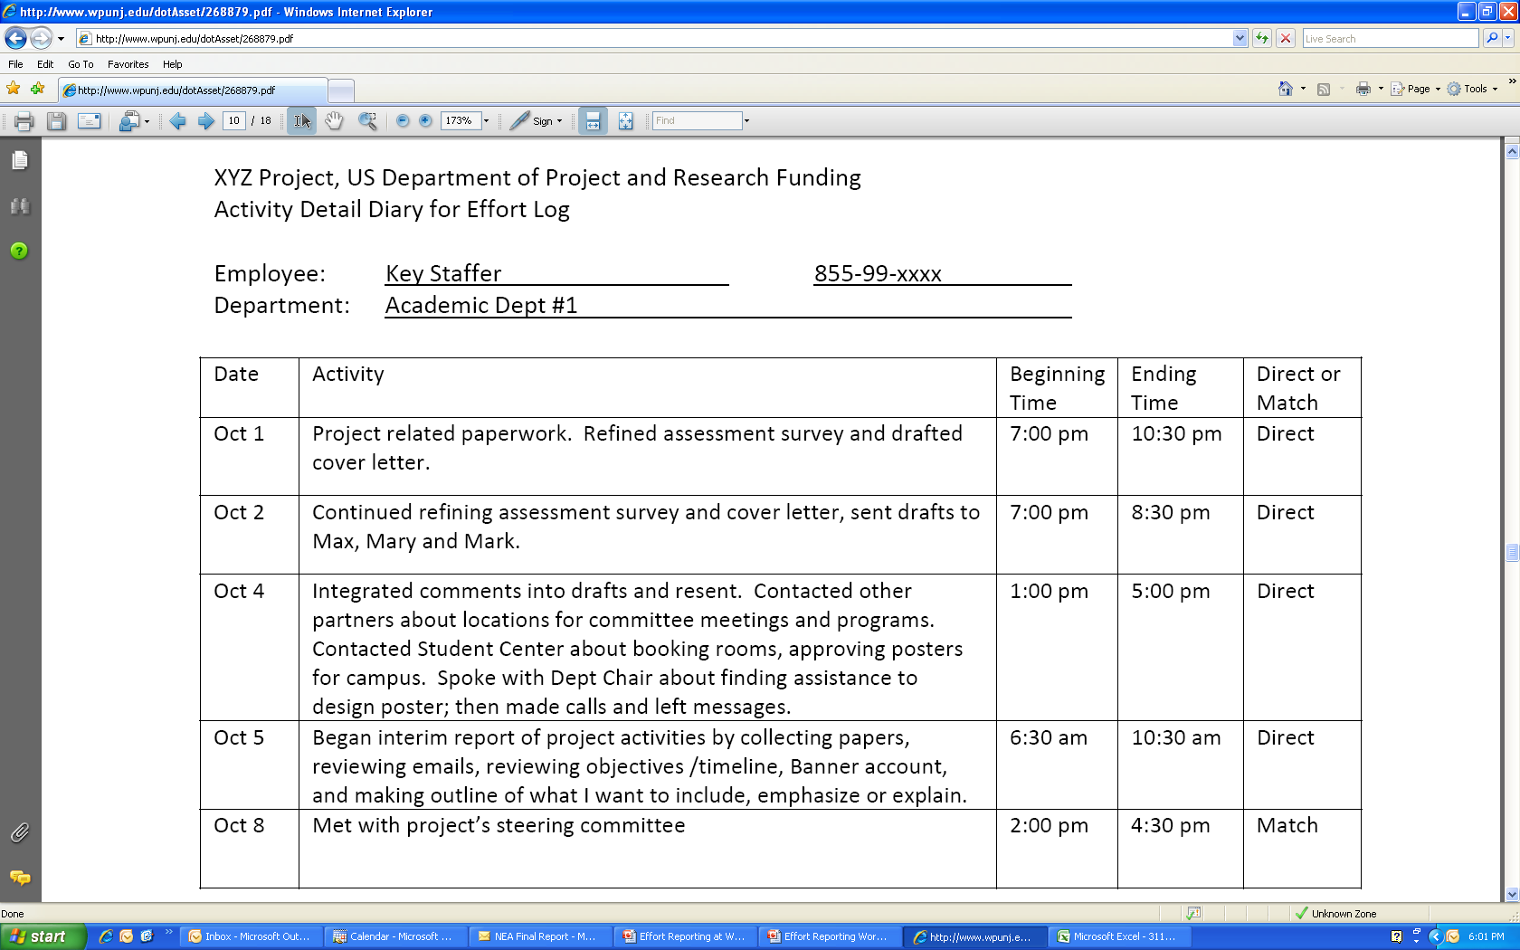
For employee’s personal use. Can be any format. May be called on to document or support Effort Log Worksheet. Should include all projects on one diary OR clearly show which activity the diary is for.
Insert Activity Diary
Notes:
This is one format that could be used to track activity for one project. While this one is typed, someone’s personal record could be hand-written.

Slide 20
Supervisor Confirmation of Effort on Sponsored Projects: Complete 3 times each year
  Information loaded from the Effort Log worksheets
  Employee prints and signs the Summary and then gives to their Supervisor
  Supervisor reviews and signs and forwards to the OSP
PI Certification of Effort
  OSP provides a copy to project PIs for review (unless the supervisor was the PI) and monitoring.
  PI compares annualized effort against proposal/contract
    Sufficient Effort: sign and return to OSP
    Insufficient/Too Much Effort (more than 5% differential)
      Remediation Plan
      Budget Modification
Notes:
This is the form that is forwarded to the Office of Sponsored Programs three times each year: In January 15 for the Fall Semester (September to December), June 15 for the Spring Semester (January to May), and September 15 for the Summer Semester (June to August).
Almost all of the information on this page is transferred from other pages in the Consolidated Effort Reporting Workbook:
Set-Up: Name and identifying information, department, and project information
Effort Log Worksheets: Total hours and average percentages of effort
This spreadsheet computes the total hours and percentages of effort for each reporting period (row) and the total hours and percentages for each project (column).

Slide 21
How and When: Supervisors & Project Directors
Everything on form is populated from other pages.
Print, sign to certify. Give to Supervisor to certify and forward to OSP.
Notes:
When the reporting period is completed, print this sheet. You sign it, your supervisor signs it and then sends it to the OSP.
Schedule:
Fall Semester (September to December) Due January 15
Spring Semester (January to May) Due June 15
Summer Semesters (June to August) Due September 15

Slide 22
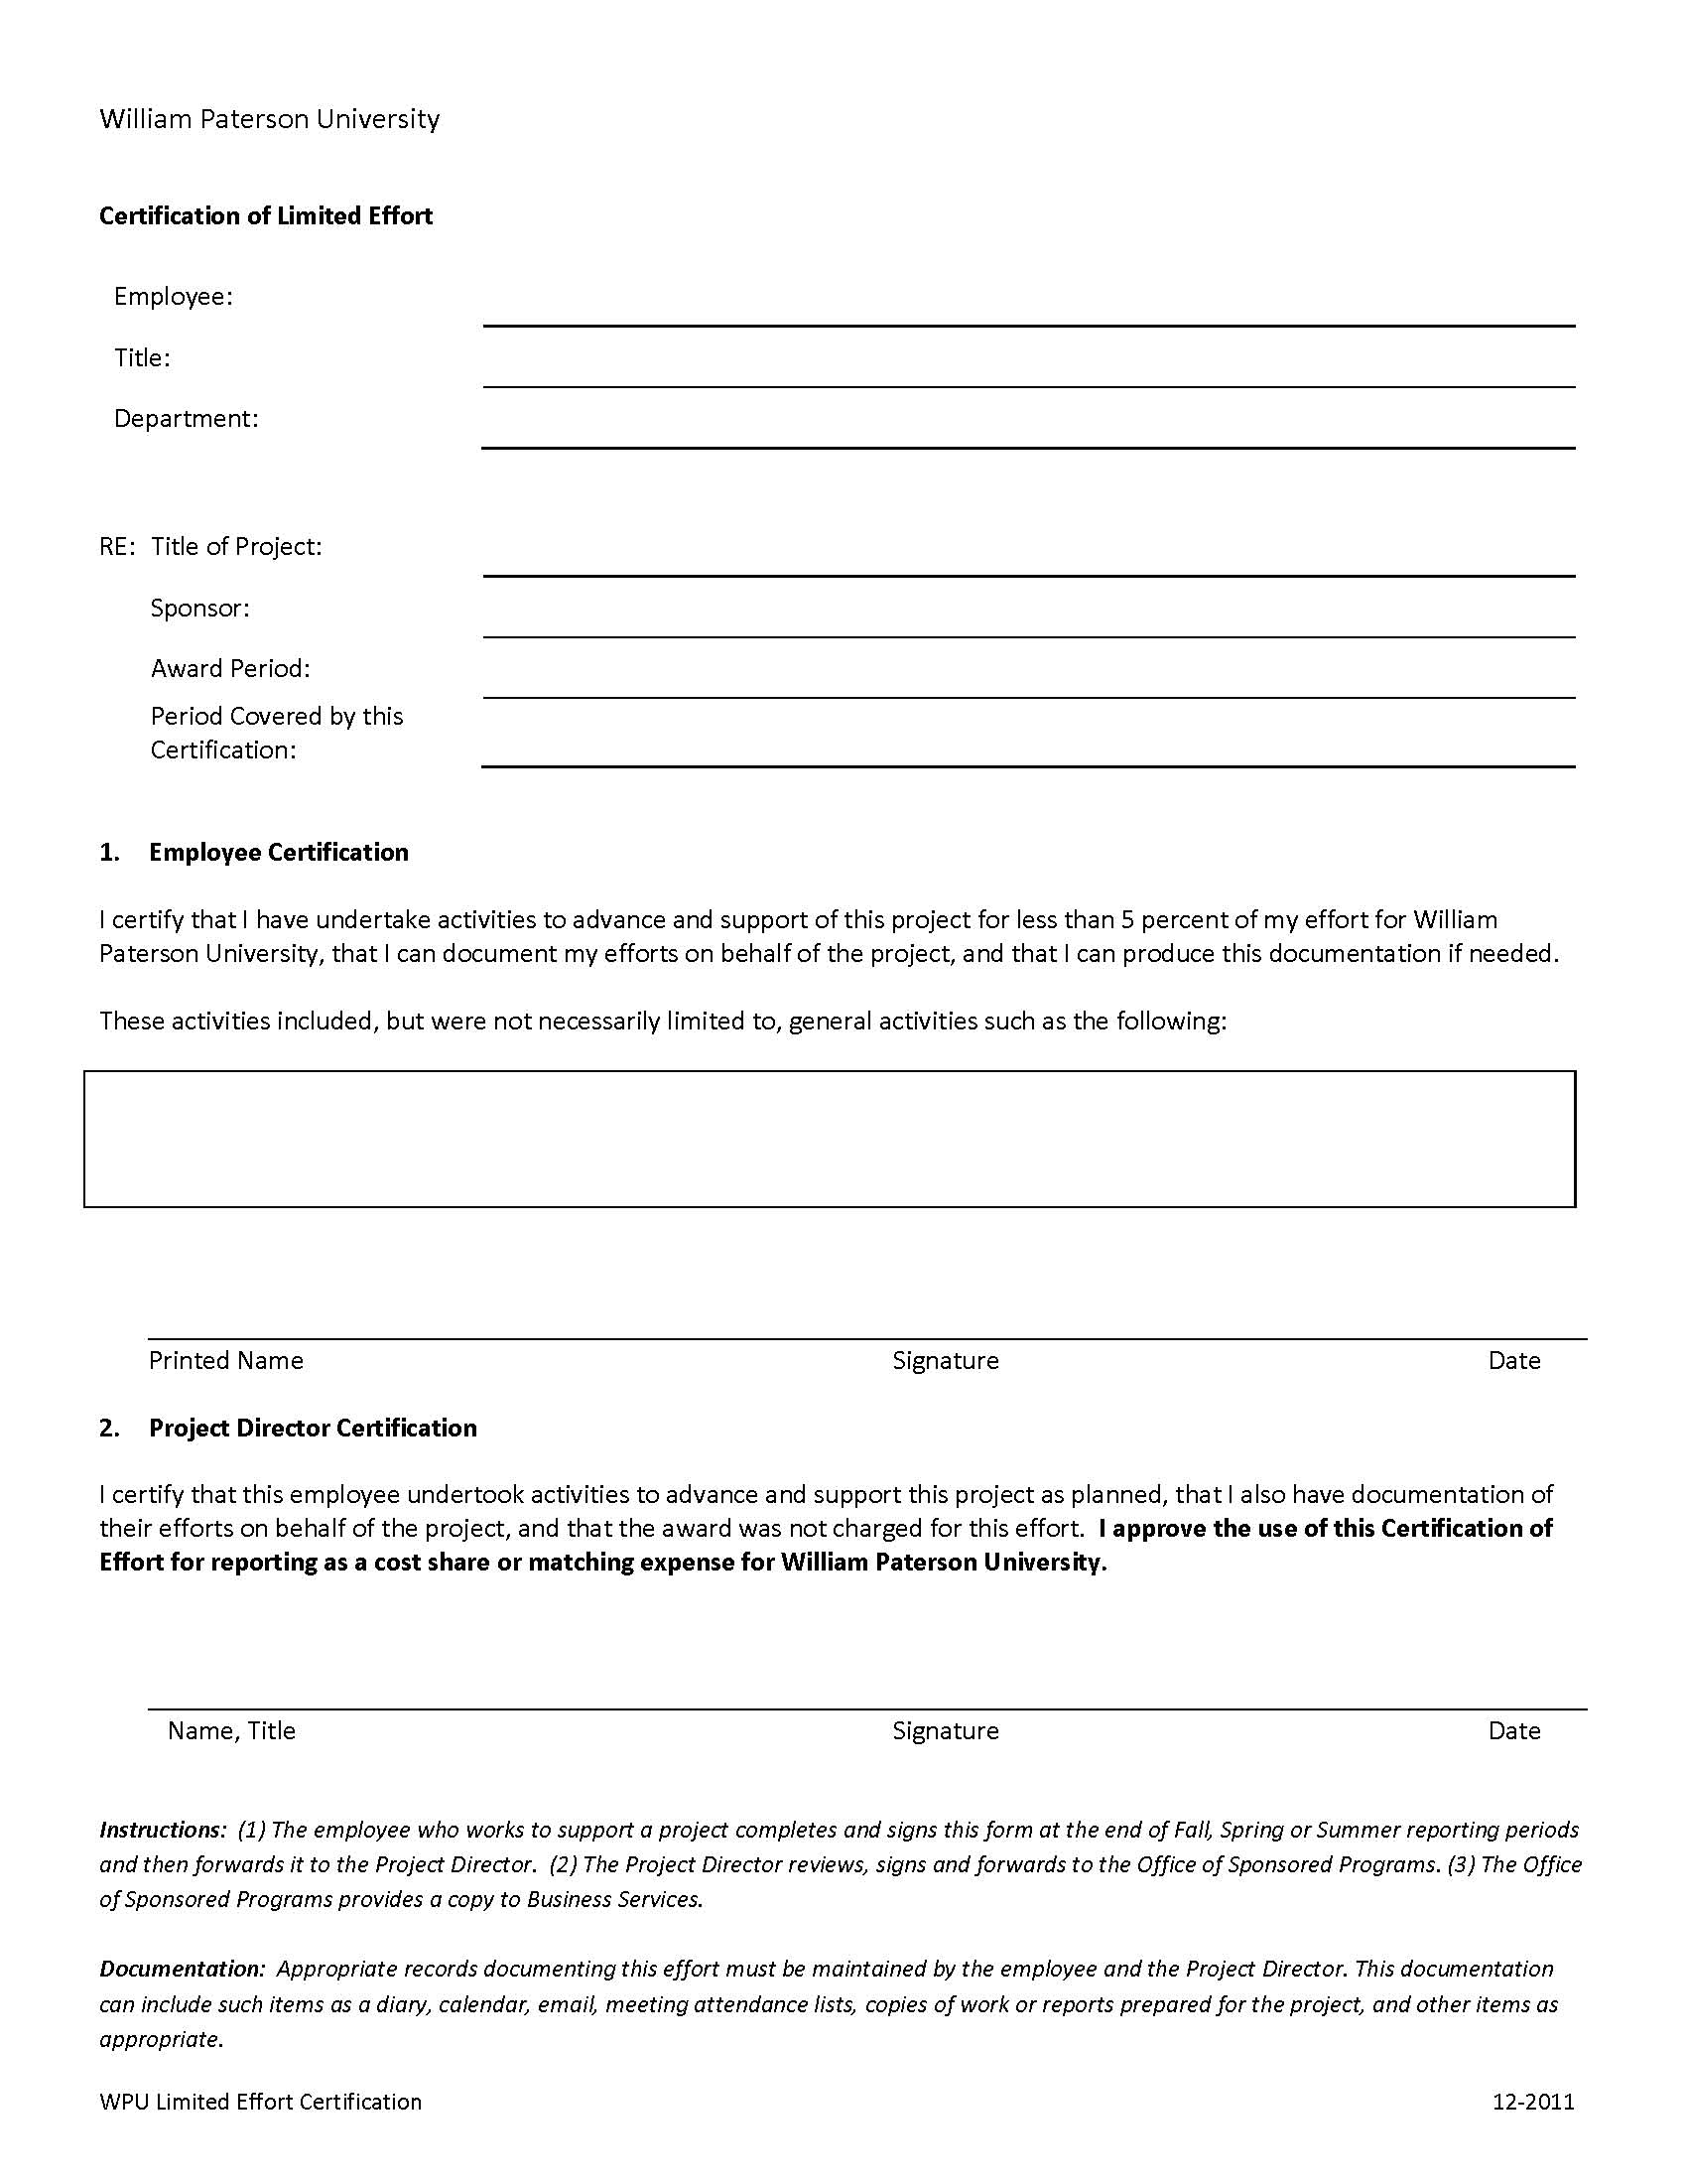
From/To depends on project and who initiates
Identify who provided the limited effort.
Provide summary of work
Everyone has to sign to certify accuracy. Maintain copy with project files, send original to OSP as you would Effort Summaries.
Notes:
The Certification of Limited Effort is used for project staff who are required to provide 5% or less of their effort to the project, whether that effort is paid for by the University or by the award. This form allows for the certification of that effort without having to complete Effort Logs or the Supervisor Certification.
When to use this form:
Anyone who provides 5% or less effort on several projects must complete one form for each project.
Anyone who provides 5% or less effort on one project but more than 5% on a different project must complete Effort Logs and submit the Supervisor’s Certification for the second project. The 5% effort on the first project would then have to be reported like any other project.
To complete this form:
Enter your identifying information.
Enter information for the project: Title, sponsor, award period, period covered by this form.
Enter a description of the activities you were engaged in during the period reported.
Sign the form and forward it to the Project Director / Principal Investigator of the project to sign.
The form is then sent to the Office of Sponsored Programs.

Slide 23
Office of Sponsored Programs
  Obtains PI/PD certifications
  Uses to justify budget modifications (limit: 25% difference)
  Uses to improve budgeting of effort in future proposals
  Maintains in project files
  Monitors “annualized” Effort
Office of Business Services
  Uses Summary certified by PD/PI to confirm percentages of salary and payroll amounts charged to the award
  Maintains copy with financial records
Notes:
The OSP is charged with receiving completed Effort Summaries, determining if the levels of effort provided are adequate (annualizing effort), and obtaining final certification from the project director/principal investigator that the levels of effort provided are adequate.
Copies of fully certified Effort Summaries are forwarded to Business Services to use in documenting the accuracy and appropriateness of payroll distribution.
If the level of annualized effort provided by a project employee is less than the expectation of the sponsor, then the OSP and the project director will review the Effort Logs of that employee – possibly with the employee – to develop a management plan that will increase the level of effort. If the level of effort cannot be raised sufficiently during the reporting period before the end of the award period, other alternatives will be explored. These other alternatives could include the formal reduction of effort and payroll through a budget modification (excess funds would be transferred to other budget expenses) or the hiring or appointment of additional staff to compensate for the lost time. If it is determined that the salary and wages paid to an employee were excessive compared to the hours worked, that employee may be subject to penalties related to submitting false timesheets and may be billed for the overpayment.
If the level of annualized effort is greater than the expectation of the sponsor, then the OSP and the project director will review the Effort Logs of that employee – possibly with the employee – to develop a management plan to decrease the level of effort. If the level of effort cannot be reduced sufficiently during the reporting period before the end of the award period, other alternatives will be explored. These other alternatives could include the formal increase of effort and payroll through a budget modification (the additional funds would be transferred from other budget expenses) or the hiring or appointment of additional staff of additional staff to manage the excessive workload. If a project’s budget is unable to provide for the excessive workload, William Paterson University may be obliged to provide the additional funds.

Slide 24
Additional Compensation
Faculty and staff may receive this if their:
  Work is across departmental lines OR involves a separate or remote operation AND
  Work performed is in addition to his/her regular department load
Charging to the project is allowable when:
  Consulting arrangements are specifically provided for in the contract (i.e.: included in the approved proposal) OR
  Approved in writing by the sponsor (i.e.: after the award because it was not included in the proposal)
Notes:
There two situations when an employee of William Paterson University may receive compensation from an award that does not need to be included on an Effort Report:
When the activity is not in their regularly assigned department or it involves a separate or remote location
a. Department: This certainly means across college or unit lines, such as a someone from the College of Science and Health working for a project in the College of Education, but can also mean someone from the Mathematics Department working in the Chemistry Department
OR
b. Location: The Valley Road “campus” is not a remote location since it is part of the University’s facilities, nor is Wayne or any of the immediately surrounding communities.
2. The work is in addition to his/her regular duties. “Regular Duties” include being identified in the proposal to provide workshops or consultation to the project or other activities in support of the project. “Regular Duties” would (generally) not include offering workshops for participants in grant funded projects or participating in a faculty development workshop that is in preparation for a possible future (not actual current) activity.
Additional Compensation can only be paid to an employee if this has been included as a budget item for the project (which means that it was previously approved by the sponsor) or there is a specific approval from the sponsor for this particular instance.
There are few exceptions to this rule. Attending or leading a professional development workshop on campus is an example of this. When the University pays you for your time for something that is outside of the activities the scope of your regular duties AND it is of limited in length or a short duration, this is considered an extra activity that is not included in your 100% time.

Slide 25
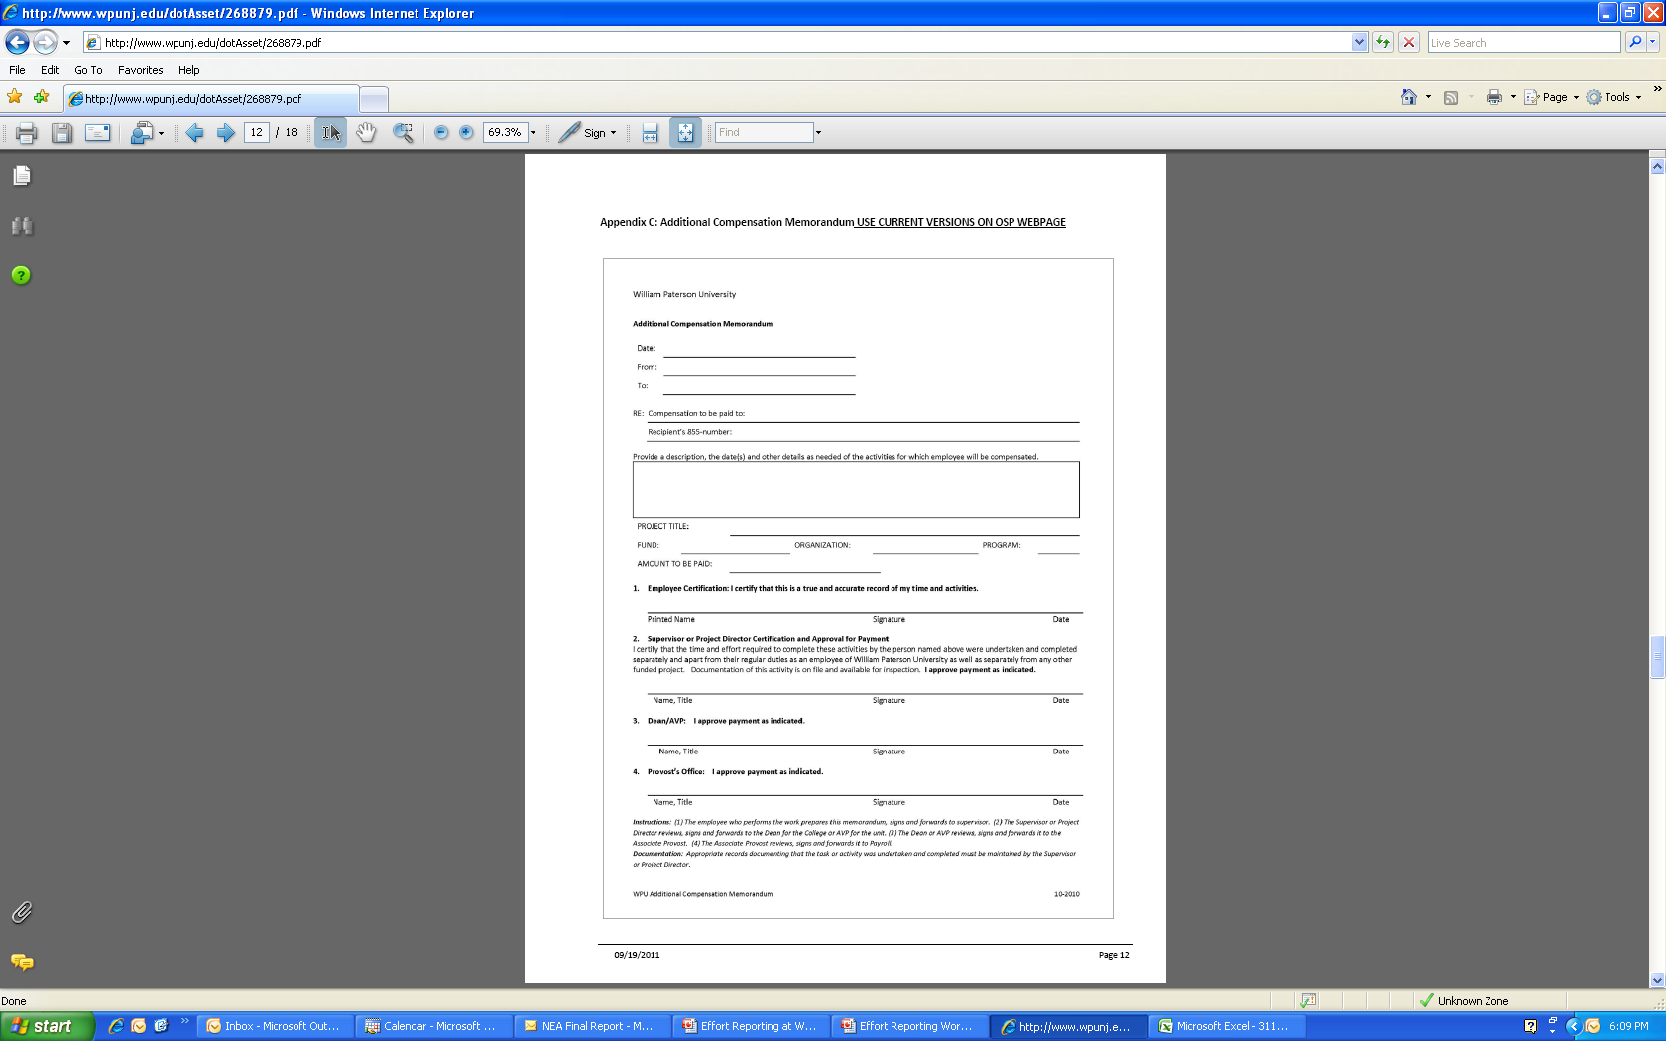
From/To depends on project and who initiates
Identify who will receive the compensation and the summary of work
Identify Banner FOP
Everyone has to sign to certify accuracy. Ultimately goes to payroll where check is cut and payment is assigned to project.
Can be used for non-award purposes. Most current version will be on website.
Notes:
To complete this form:
Enter the name of the Project Director or Principal Investigator (who will sign as #2) and their Dean or Associate/Assistant Vice President (who will sign as #3)
Enter the identifying information for the person who will receive the compensation.
Enter a description of the activities you were engaged in during the period reported.
Enter information for the project: title of the project, FOP and amount to be paid. Please also identify the Account Code if it known.
Signatures:
The person who will receive the payment must sign to certify the accuracy of the request.
The Project Director/Principal Investigator must certify that this is an approved and appropriate activity for their project.
The Dean/AVP and the Provosts’ Office certifications enable the payment of the compensation.
Specific routing instructions are included on the form.

Slide 26
Additional Information and Support
Office of Sponsored Programs
  OSP Webpage: section on Managing Awards
    www.wpunj.edu/osp/managing-awards.dot
  Contact:
  Martin Williams, Director, WilliamsM@wpunj.edu
  Cleavens Estriplet, Post-Award Coordinator, EstripletC@wpunj.edu
  Telephone: 973-720-2852
  Location: Raubinger Hall, Room 309

