Slide 1
Finding & Applying for Grants
“ It’s All About the Program”
Office of Sponsored Programs
Raubinger Hall, Room 107
William Paterson University
973-720-2852 November 17, 2010

Slide 2
Agenda
Resources available to search for grants at WPUNJ
WPUNJ Process, Policies and Procedures regarding grants
How to develop a fundable grant proposal

Slide 3
Resource #1:
The Office of Sponsored Programs
Primary Focus:
  Proposals to government agencies, public charities and large foundations
  Support for research, teaching, community service, public programs, creative endeavors, conferences, other
Three Major Areas of Activity:
  Pre-Award Services & Resources
  Post-Award Services & Support
  Compliance

Slide 4
Pre-award Services & Resources:
Funder identification, reference center
Publications:
  Dates, Updates & Insights (DUI) email announcements
  STAR Report
  Web site
Training: at WPU and conferences; funder visits
Idea and project development, proposal preparation guidance/assistance, institutional review, submission
Support and encouragement:
  Senate Research Council, University Research & Scholarship Day
  Conferences, meetings with funding agencies

Slide 5
Contact Information:
Staff:
    Martin Williams, Director
    Lourdes Bastas, Assistant Director for Pre-Award Services
    Beth Ann Bates, Program Assistant
    Graduate & Undergraduate Assistants
    Nina Jemmott, Associate Vice President and Dean, Graduate Studies and Research
Office:
    Raubinger Hall 107
    Phone: 973-720-2852, fax: 973-720-3573
    Email: williamsm@wpunj.edu; bastasl@wpunj.edu
Webpage:
    www.wpunj.edu/osp

Slide 6
Resource #2: Search Tools: Print Format
Directories and Newsletters
    Comprehensive or General Interest
    Special Interest: Agency, association and third-party
      Multiple indexes: subject, type, location
    Featured Element in a general interest publication
Other publications
    Professional journals
    Newspapers

Slide 7
Resource #3: Search Tools: People
Office of Sponsored Programs Staff
Colleagues
    In department, professional associations, peers
Conferences
    Grants Major Element:
      Grant Resource Center, Training Workshops
      National Council of University Research
    Grants Minor Element: Session or exhibitor

Slide 8
Resource #4: Search Tools: The Internet
Internet-based Databases Subscriptions
    Grant Search
    COS Funding Opportunities
    Grants.Gov
Free Internet Search Tools
    What’s your favorite search engine?
    Organizations: e.g. Foundation Center
Helpful Hints: Use “Keywords” or funder’s terms
Start narrow then broaden

Slide 9
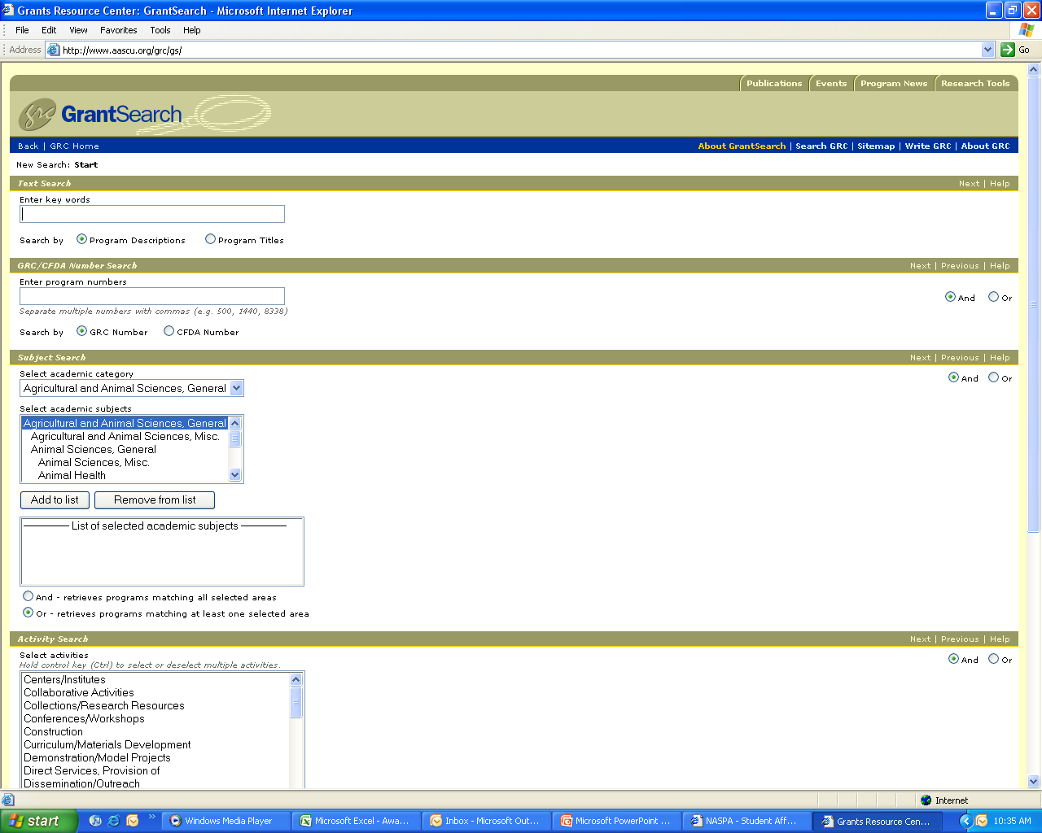

Slide 10
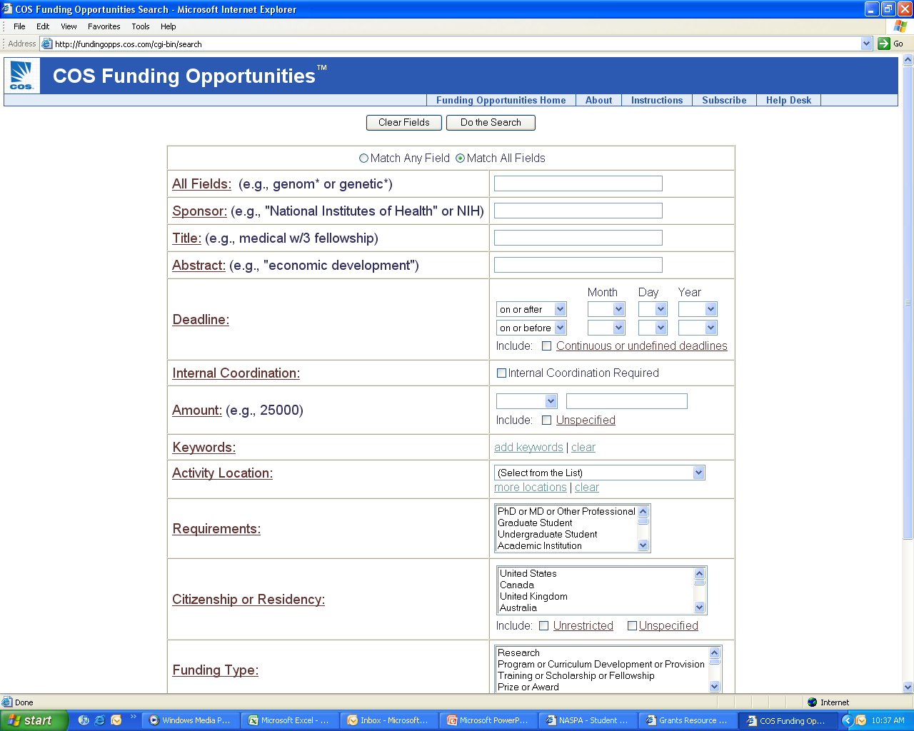

Slide 11
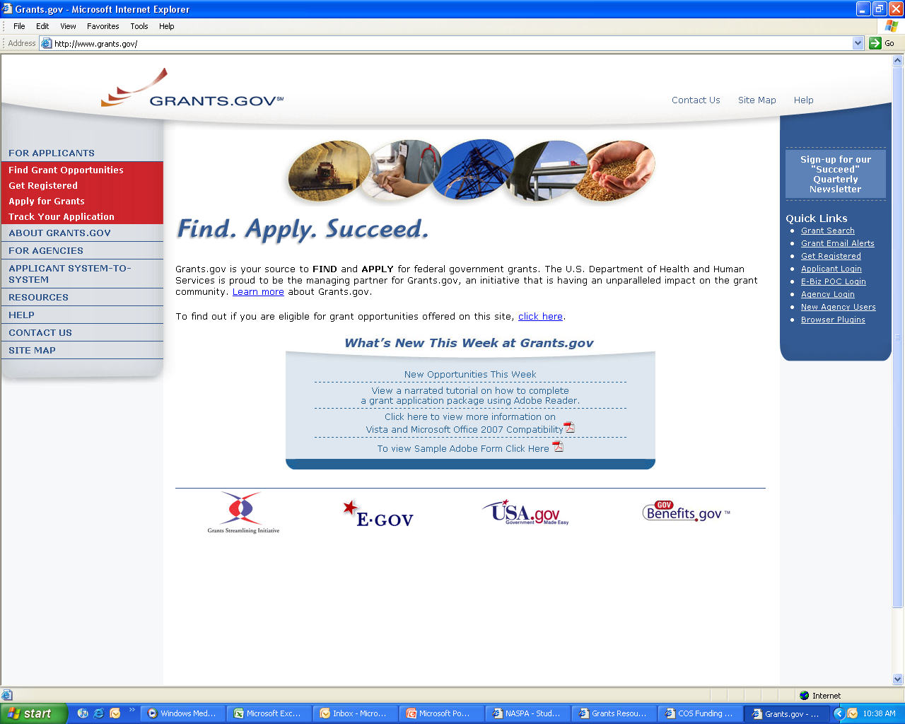

Slide 12
Grant Development Process
Initiate Idea
Find appropriate funders
Refine idea, develop project, outline proposal
Meet with OSP; contact funder
Draft proposal; contact consultants and partners, begin collecting support materials
Meet with OSP to review draft, develop budget, schedule submission
Submit nearly finished narrative and budget for review and signature, about 10 days to deadline
Finalize proposal package, submit early

Slide 13
WPUNJ Policies & Procedures:
Grant Approval Sheet:
Documents official support for project
Summarizes key elements, identifies special review needs
Assists in time management and in orchestrating the final review process to meet submission deadline
Project Director obtains Chair & Dean signatures
OSP obtains Administration & Finance signatures, Provost Office signatures, and signatures on proposal, support letters and other required documentation
Due in OSP 10 days before due date to:
  Obtain final signatures
  Assemble packet and prepare final documents and copies
  Submit

Slide 14
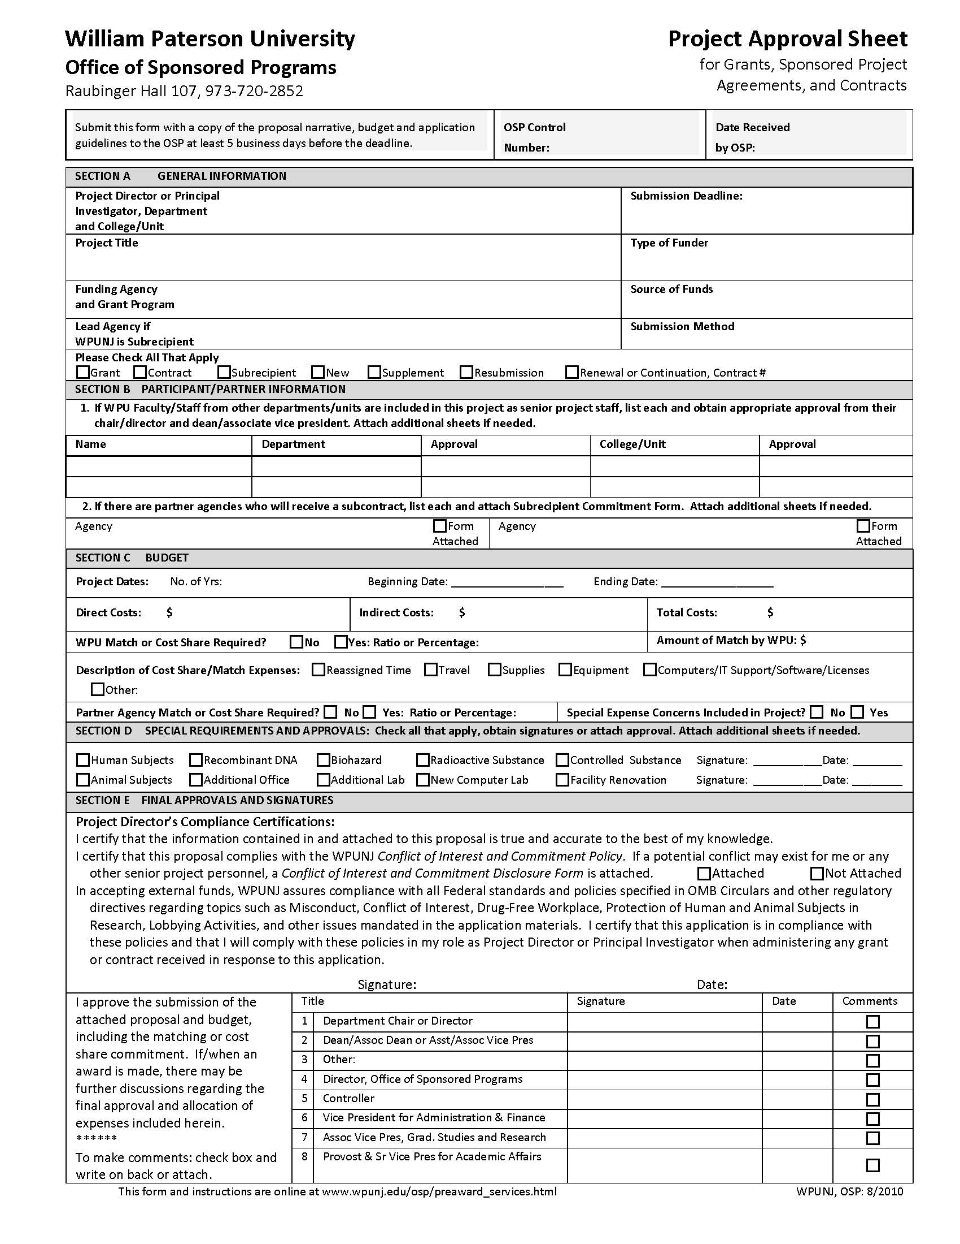
Project
Approval
Sheet

Slide 15
How to Develop a Fundable Proposal
Overview of a Complete Proposal
Guidelines First!
Review Criteria & Processes
Developing Each Component
Some Helpful Hints

Slide 16
Overview of a Complete Proposal
Cover Page, forms, signatures
Budget, budget support, other forms
Abstract
Narrative
  Background and problem statement
  Goals and objectives
  Activity Plan
  Evaluation
Appendix and support material

Slide 17
Guidelines First!
Read the Guidelines Thoroughly to:
  Verify Eligibility for the grant program
  Establish Connection to the funder’s mission, goals and the grant program’s expected outcomes
  Learn the Details of the application process, format, including special information or review requirements
  Get Answers to Questions: Call the Program staff!
  Evaluate whether the program is right for you, your project and the University

Slide 18
Review Criteria: Content
The first & most important review issue is
  Intellectual Quality/Merit/Significance:
  How will the project advance “knowledge and understanding in its own field or across different fields?” (NSF)
  Does it “address an important problem?” & “How will
  scientific knowledge or practice be advanced?” (NIH)
  ”Is it “broadly conceived, based on sound scholarship, and appropriately analytical?” (NEH)
  ” The extent to which the design of the proposed project reflects up-to-date knowledge from research and effective practice.” (US Dept of Education)

Slide 19
Other Aspects of Intellectual Quality/Merit/Significance
  Other Intellectual Quality Issues:
    Originality/Innovation: Does it address an innovative hypothesis or employ novel concepts, approaches, methodologies, tools or techniques?
    Validity of the need, goals, objectives and supporting information as presented
    Quality of participants
    Realistic design and likelihood for success
    Conducive facilities and environment

Slide 20
Review Criteria: Content
The second most important review issue is
  Potential Broader Impact
  On project participants (you, others; direct, indirect)?
  On the service/support environment/infrastructure?
  Of the data or insights to be produced?
  Of how others will use the outcomes?
    A Key Aspect to address is dissemination:
    How will you share the outcomes with others?

Slide 21
Other Aspects of Potential Broader Impact
  Other Broader Impact Issues:
    How well will the project/activity:
      Promote integration of service, research and education?
      Broaden the participation of underrepresented groups (e.g. genders, racial/ethnic minorities, persons with disabilities)?
      Benefit your community and society in general?

Slide 22
Review Criteria: Technical
Was a Letter of Intent or Preliminary Proposal Required?
Forms: Cover sheet, summaries, assurances
Format: Length, margins, font size, attachments
Organization: Specific sections in specific order
Special Requirements: Human Subjects, ADA
Letters of Commitment: Partners, Evaluators
→ THESE ARE EASY EXCUSES TO REJECT PROPOSALS

Slide 23
Review Process
1. Self/Institutional review before submitting
2. Technical review when received
3. First program staff review
4. Peer/Committee review: selection and scoring
5. Second program staff review: ranking and selection
6. Program executive officer/board review: approval
7. Contract office review: negotiation and award

Slide 24
Developing Each Component
1. Activity Plan
2. Budget
3. Goals & Objectives
4. Background, Need(s), Problem(s), Benefits
5. Introduction: Credibility of PI/PD, WPU, etc.
6. Detailed Evaluation Plan
7. Detailed Dissemination Plan
8. Future Activity
9. Summary/Final Introduction

Slide 26
Before the Proposal
Research
  Similar programs, core issue, related issues
  Gather data supporting your idea and proposed of activities (census, research findings)
Undertake preliminary activity
  Test proposed activities and/or collect preliminary data
  Determine outcome estimates
DEVELOP THE PROJECT
  Don’t wait until you start writing
  Will identify issues that need resolution
  Provides time to think about what you are going to do

Slide 27
1. Activity Plan or Methodology
Rationale: Why are you doing project this way?
  Literature review, programs at other institutions
  Preliminary activities, outcomes and data
Activities Plan and Accomplishments:
  Tasks
  Timeline
Personnel: Who will perform each task?
Resources: Facilities, Equipment, Supplies, Money?
DETAILS! DETAILS!

Slide 28
2. Budget
Budget Summary
  Total expenses by category
Budget Detail or Narrative
  Present as narrative or spreadsheet (or both)
  Provides details on expenses by category
  Provides fiscal perspective on the project and narrative
  No expenses included in the budget that are not identified in the narrative
  No expenses in narrative that are not in the budget

Slide 29
Sample Budget

Slide 30
Typical Budget Categories
  Salaries
  Fringe Benefits
  Supplies
  Consultants
  Travel & Conferences
  Equipment (agency defined)
  Participant Costs (tuition/stipends, other)
  Indirect/Overhead Costs
Multiple Year Budget?
Adjust for
salary increments
variable expenses
non-repeating expenses

Slide 31
3. Goals, Objectives, Outcomes
Goal: A broad statement of the ultimate result of the research or change being pursued
Objective: The narrowly defined, measurable and time-specific result you expect to accomplish
    Process vs. outcome objectives; Action verbs
    Interventions: To [direction of change] + [area of change] + [target population] + [degree of change] + [timeframe]
    Research: To [specific research activity] then [impact of research] on [status of problem/need] + [timeframe].
Outcomes: Short term accomplishments and long term impacts, direct and possibly indirect

Slide 32
4. Problem and Need Statement
Defines what the project will address
    Who, what, where, when, why?
Hard evidence and documentation
    Statistics, data, evidence
      From your literature search & preliminary activities
      Authoritative: Census data, government reports, credible experts and publications
    Anecdotal evidence gives life to statistics
Impact/outcome if problem is addressed
Link outcome to missions (You & funder)

Slide 33
5. Introduction: Credibility
  Concise statement of project goal, including problem/need addressed and objectives
      Crucial information reader needs to know
      Discuss importance, innovation, creativity
  Concise statement describing project activities and key outcomes expected
      Crucial information reader needs to know
  How project addresses the funder’s priorities
  Related organizational and staff experience
      Previous successful related experience

Slide 34
Discipline, Project & Grant Program-Specific Activity Plan Components
These vary significantly based on the nature of the project, your discipline, and the specifics of grant program:
6. Evaluation/Assessment:
    What will success look like?
    How will it be documented? External Consultant(s)?
7. Dissemination of Results:
    Think realistic and attainable! Publications & Conference Presentations; Webpage?
8. Future Activities and Impact:
    Sustainability: $$$/infrastructure; You & your field
    If seed or start-up, this is very important

Slide 35
9. Proposal Summary or Abstract
Stands alone at beginning
    First for agency staff and reviewers
    Important as public summary of project
      “Professional English” as well as “Plain English”
    May have special content requirements
    Limited length – usually one page or less
Touches on all key details of project
    Ones that define the importance, impact and scope of the project: Goal, objectives & outcome
    Ones that are most important to the funder
    Ones that distinguish your project from others

Slide 36
Appendices
Summary Vita/Resume or Biographical Sketch
    Education and work history
    Related programmatic, research, publication or professional activities and experiences
    Leadership and peer-acknowledgement
Letters of support
Work or publicity samples
Agency history, background and plans
Agency tax status and financial statements

Slide 37
How you probably feel right now !
Grant proposals
are hard – but very
“do-able.”

Slide 38
Helpful Hints: Content
Be innovative wherever possible
  Based on what others are doing
Focus on key questions
Be convincing and thorough
Demonstrate knowledge of subject
State the expected contributions (outcomes) to your field of work
Convey excitement and commitment
Clearly link to the funder’s priorities

Slide 39
Helpful Hints: Structure
Clear, concise sentences
Use section- and sub-headings
Use page headings and number pages
Avoid or define jargon or technical terms
Be specific – Do not make readers assume
    Objective: “To increase rate by 25% in 2 years.”
    Activity: “The PI and a student will travel to North Park to collect samples on ten consecutive Saturdays. A sample will consist of . . .”

Slide 40
Helpful Hints: General Tips for Success
Follow the directions/answer their questions
Talk to the Program Officer
Fulfill their review criteria
Ask for what you need
Be thorough in describing the project
Do not do the project or writing alone
Schedule time to write
Start early to insure there is enough time
Everything must “fit together”:

Slide 41
The Ultimate Goal of a Proposal
Abstract

Slide 42
Contact Information
Staff:
    Martin Williams, Director EXT 3263
    Lourdes Bastas, Assistant Director, Pre-Award Services EXT 3794
    Beth Ann Bates, Program Assistant EXT 2852
    Nina Jemmott, Associate VP & Dean,
    Graduate Studies and Research EXT 3093
Office:
    Raubinger Hall 107
    Fax: 973-720-3573
    Webpage:
    www.wpunj.edu/osp

