Slide 1
Human Subject Research by Students at
William Paterson University
May 2011

Slide 2
Institutional Review Board for Human Subject Research
Empowered by the University to insure we are in compliance with Federal regulations
Committee of faculty, staff and an outside, unassociated member
Guided by the standards in the Belmont Report and regulations in The Common Rule (45 CFR Part 46)
Main focus is faculty research

Slide 3
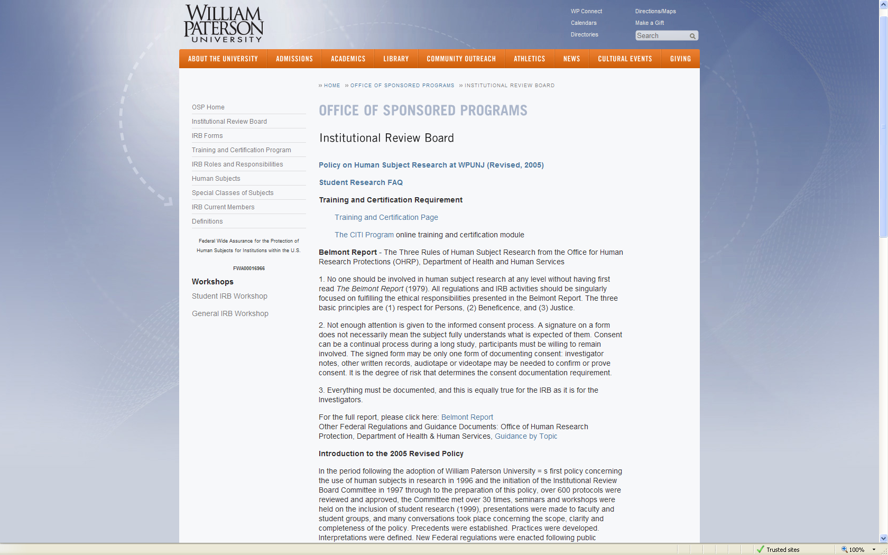
http://www.wpunj.edu/osp/irb

Slide 4
The IRB is concerned with:
  Research involving living human subjects that results in the advancement and dissemination of generalizable knowledge.
That is conducted by:
  Faculty and Staff
  Undergraduate and Graduate Students
Ethical Basis (Belmont Report):
  Respect for Persons
    Autonomous individuals entitled to be protected
  Beneficence
    Do no harm; maximize benefits and minimize risks
  Justice
    Burdens and benefits are appropriately distributed between subjects and beneficiaries

Slide 5
What the IRB reviews
Biomedical or social/behavioral research
WPU policy specifically excludes:
    classroom demonstrations, exercises and/or experiments designed for the exclusive purpose of education.
    Pedagogical research done in the investigator’s own classroom.
    Oral history interviews done for historical research purposes and some sociological and anthropological purposes but not any social/behavioral or biomedical purposes.
    Research conducted by the University (or parts thereof) concerning its activities and with its own constituencies.

Slide 6
Student research is reviewed when:
  The research involves a vulnerable population
  The research collects identifying information on the research subject
  The research goes beyond what is normally expected for the course
  The research concerns a highly sensitive subject
  The research plan has potential serious physical or psychological risk for the subject or the researcher
Faculty or Research Mentors
  Decide what student work needs review
  Supervise their students and are responsible for what their students do
  Must complete and provide IRB with Certification of Training

Slide 7
Vulnerable populations: Federal Regulations
Federal guidelines define vulnerable populations as those people who do not have the ability or capacity to freely choose to participate in the proposed research.
Specifically Identifies & Protects:
  children and minors
  prisoners
  fetuses
  pregnant women
Other Covered Populations:
  persons with diminished capacity
  English language limitations

Slide 8
Vulnerable populations: WPUNJ
WPUNJ expanded specifically identified groups to include respondents who may perceive that their responses may have an impact on them, such as:
  residents of nursing homes
  patients in hospitals
  students in classes of the researcher
  employees of businesses

Slide 9
Student Research
Student develops research plan, including data collection instruments and informed consent statements, which is approved by professor or research supervisor
Student prepares the Student Research Protocol Review Request and obtains faculty signature
Student delivers the Protocol to the IRB with attached copies of the data collection instrument(s) and proposed Informed Consent Statement
IRB completes review unless there are questions or issues to resolve

Slide 10
Protocol Review Request
Investigator provides answers to questions concerning the research plan and subjects.
  Hypothesis
  Research Plan/Methodology
  Human Subjects
  Outcomes, Risks and Benefits
  Schedule
Must be signed by investigator and his/her professor/advisor.
Available online in Word and .PDF at: http://www.wpunj.edu/osp/

Slide 11
Protocol Review Request
Professor/advisor decides whether or not to forward protocol to the IRB.
The IRB looks at how the research will be carried out and what impact it will have subjects
The IRB does not review or approve the subject matter or research topic, this is agreed to by the student and their professor/advisor, but the IRB can ask about it as it relates to subjects and proposed research plan.

Slide 12
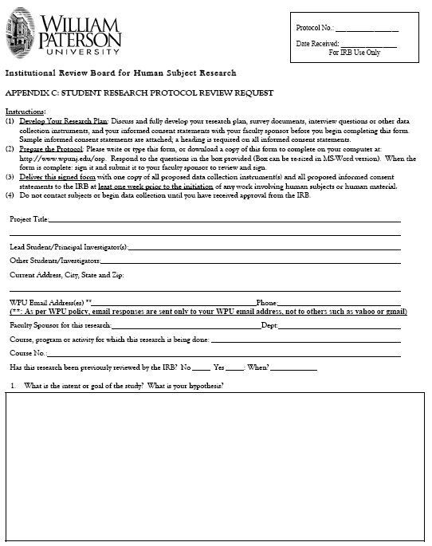

Slide 13

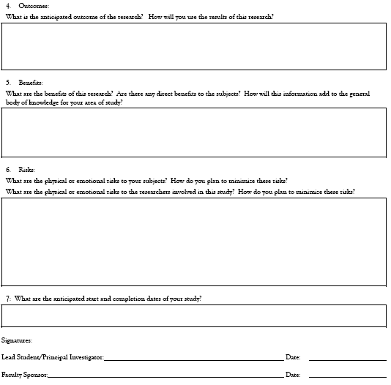

Slide 14
Data Collection Tools
Survey or questionnaire
  Original
  Acquired
    Purchased
    Available
Interview Questions
Observation sheet
Other

Slide 15
Informed Consent
An Informed Consent Statement must provide enough information to insure that subjects…
  Have the freedom to choose whether or not to participate in the research,
  May leave the study at any time without penalty,
  Understand and agree to do what is expected to participate in the research,
  Understand and agree to the risks and benefits associated with participating,
  Understand how their participation is kept confidential,
  Understand whether or not their participation will be anonymous and who will know their identity if it is not,
  Understand who to contact with questions or concerns about the research project or the way it is conducted

Slide 16
The format of an Informed Consent Statement is based on the amount of detail required by the research plan and the extent of contact with subjects:
  Invitation to participate
  Spoken formula
  Short statement at top of page
  Separate sheet without signature
  Separate sheet with signature
  First page online
Minors must have opportunity to assent to participate, even with parental consent
Permission to use a site does not provide consent for the subjects at that site
Observation of public behavior does not require informed consent by subjects

Slide 17
There are two types of Informed Consent Statements used at WPUNJ
Passive consent or agreement
    Participation is subject’s statement of consent to participate in the research
    Limited to anonymous surveys
Active consent or agreement
    Signature required prior to participation
    For interviews and physical contact with subjects, collection of personally identifying information, and ongoing contact with subject
    For young children and minors, will include their assent along with parent/guardian consent
    Witnesses are only needed when the subject is unable to provide effective informed consent

Slide 18
Names cannot be connected directly to data tools or instruments.
Use a coding system that connects data tools or connects data to subjects without revealing subject identity.
Maintain data and code key separately.
The WPU IRB provides samples of Passive and Active Informed Consent Statements
  DO NO NOT USE AS IS!
  DO NOT SIGN!

Slide 19
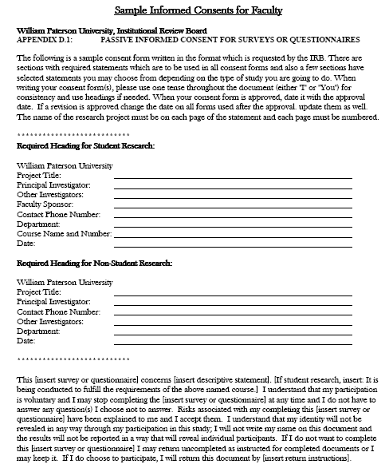

Slide 20
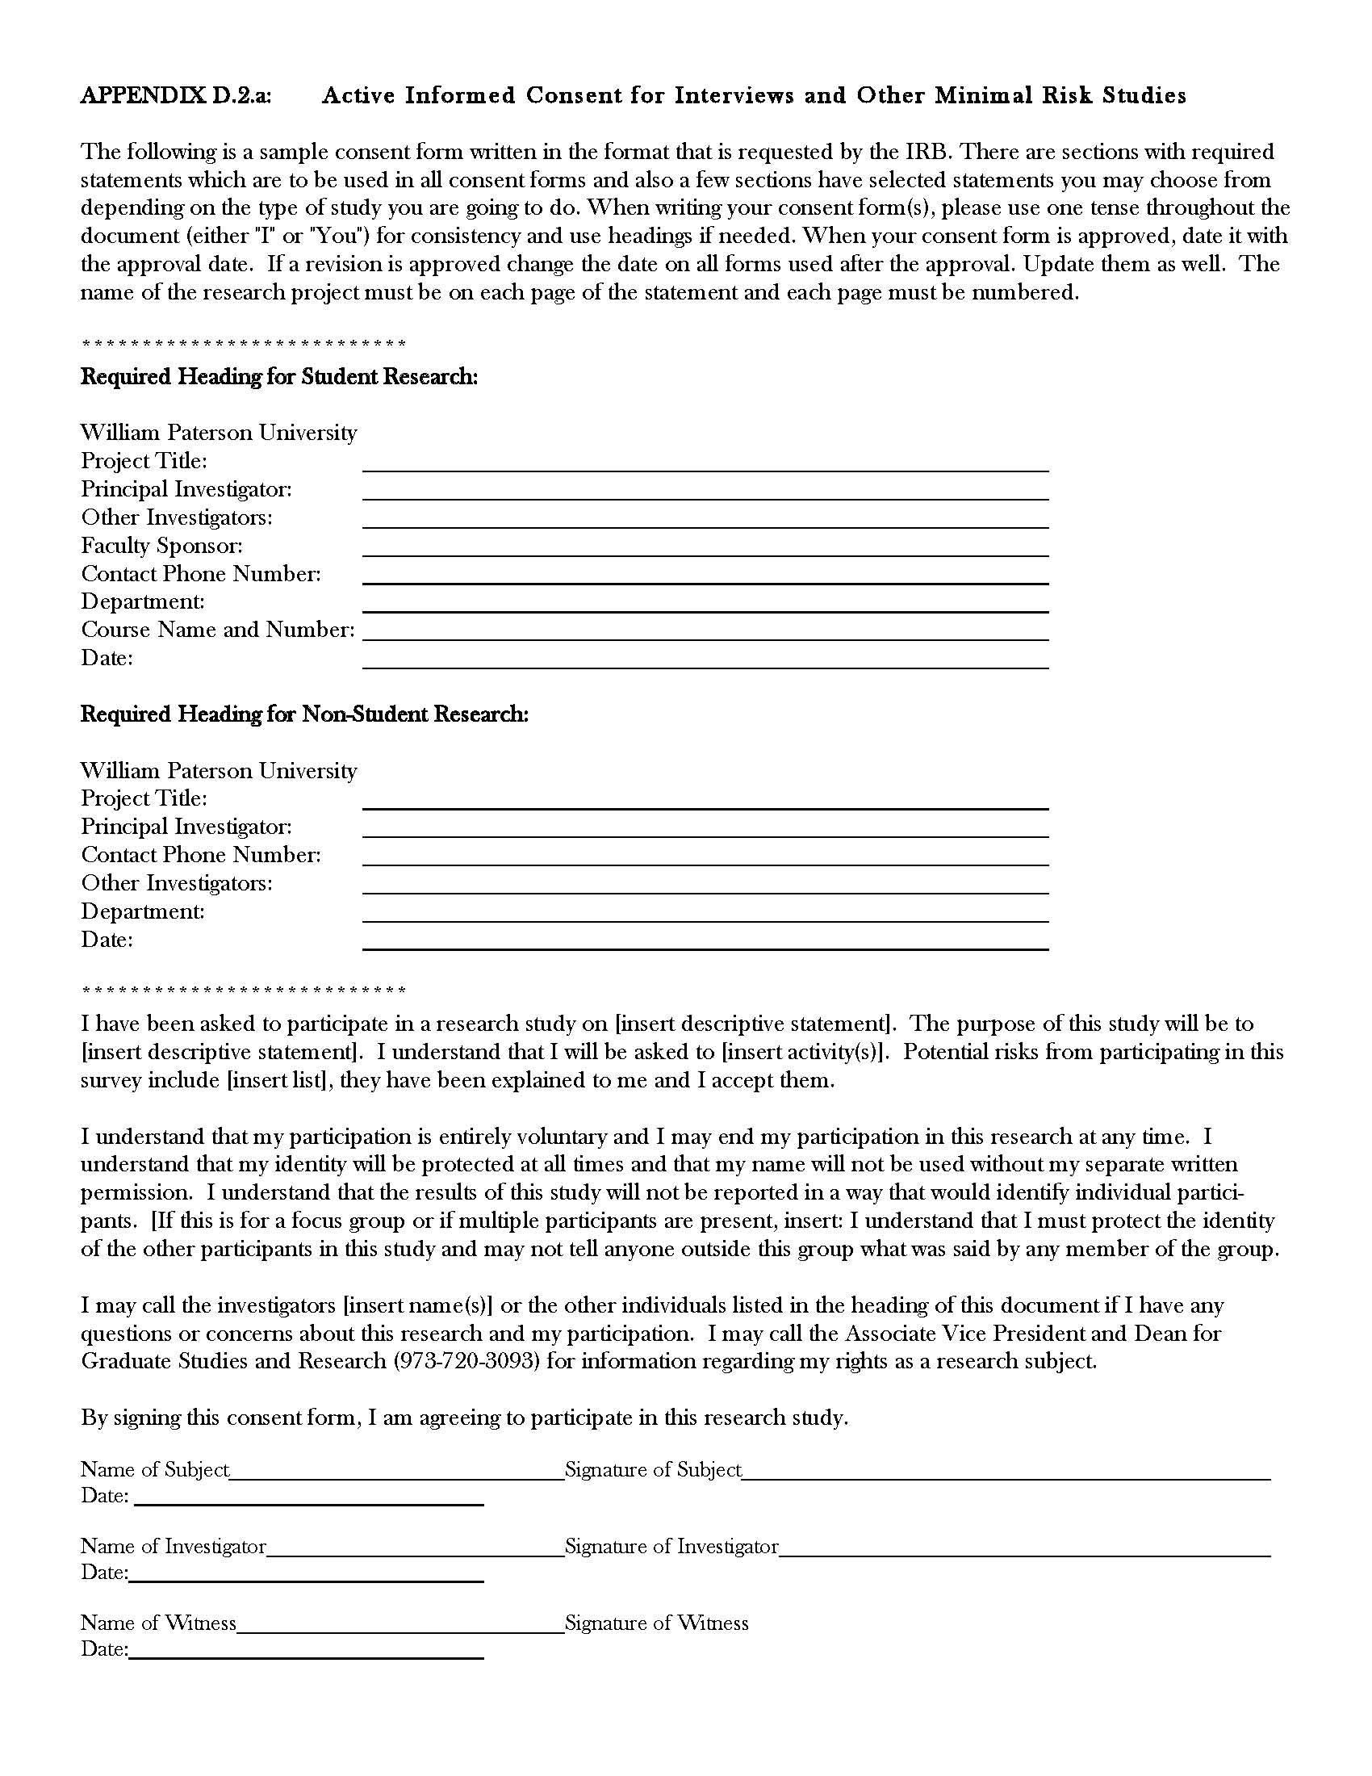

Slide 21
Questions . . .
Contact
    --Betty Kollia
    Chair, WPUNJ IRB
    Asso. Professor, Comm. Disorders
    KolliaB@wpunj.edu
    --Martin Williams
    IRB Administrator
    Director, Office of Sponsored Programs
    WilliamsM@wpunj.edu
    --Beth Ann Bates
    Program Assistant, Office of Sponsored Programs
    BatesB@wpunj.edu
    Phone: 973-720-2852
    Location: Raubinger Hall, Room 107
    Website: http://www.wpunj.edu/osp
    All Forms Available On Website!

